Slide 1
PDC Webinar December 10, 2015 _______________________________________
HOSTED BY:

Slide 2
Public Disclosure Commission Webinar Speakers:
Heidi Maynard
Director - Policy and Legal Services, WSSDA
Jon Gores
Managing Director, D.A. Davidson & Co.
Roy Koegen
Partner, Kutak Rock LLP
Brian Kistler
Of Counsel, Kutak Rock LLP

Slide 3
Today’s Presentation Will Focus On:
Election Results
Questions
1
4
PDC Overview
2
PDC Case Scenarios
3

Slide 4
Washington State Election Results School Districts Only
2013
M&O Levies 44 Passed and 1 Failed
Capital Projects Levies 16 Passed and 2 Failed
Transportation Levies 1 Passed and 0 Failed
Bond Authorizations 15 Passed and 16 Failed
2014
M&O Levies 160 Passed and 3 Failed
Capital Projects Levies 49 Passed and 3 Failed
Transportation Levies 1 Passed and 1 Failed
Bond Authorizations 13 Passed and 27 Failed
2015
M&O Levies 46 Passed and 2 Failed
Capital Projects Levies 16 Passed and 2 Failed
Transportation Levies 2 Passed and 1 Failed
Bond Authorizations 23 Passed and 22 Failed
Source: Washington Secretary of State: Election and Voting website and individual County Auditor websites

Slide 5
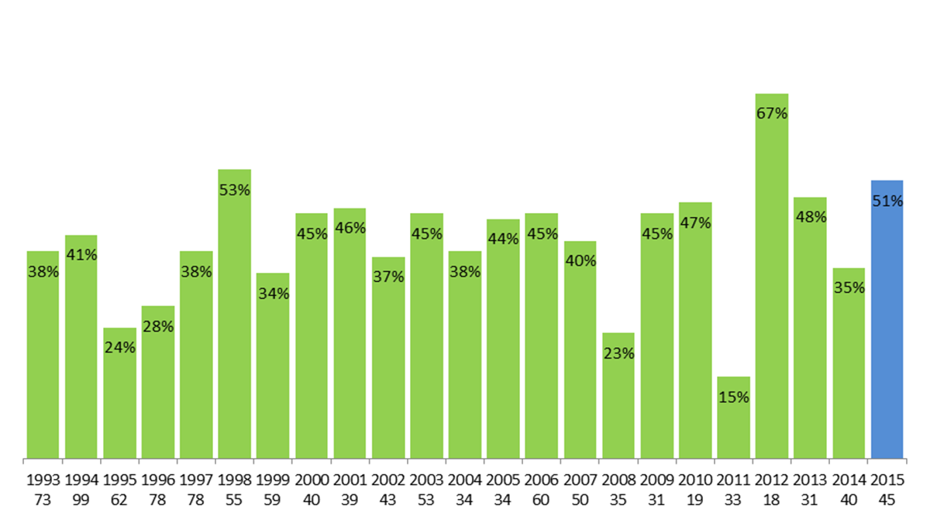
Bond Issue Passed Per Year-Schools Only (Years 1993 through 2015-inclusive)
Source: Washington Secretary of State: Election and Voting website and individual County Auditor websites

Slide 6
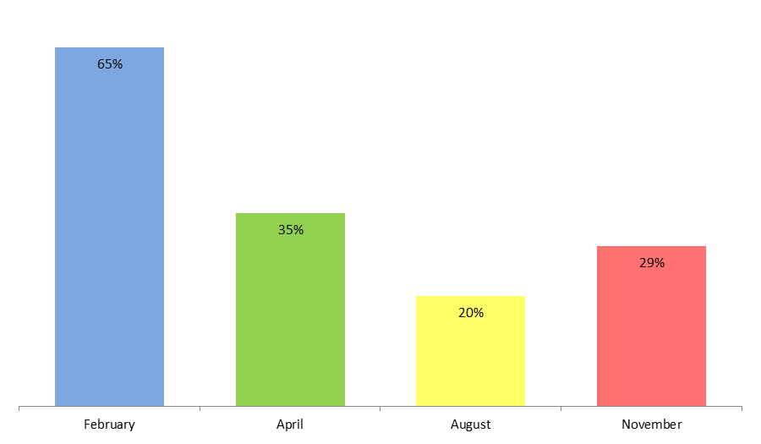
Bond Issues by Month-Schools Only (Years 1992 through 2015 inclusive)
512 99 5 156

Slide 7
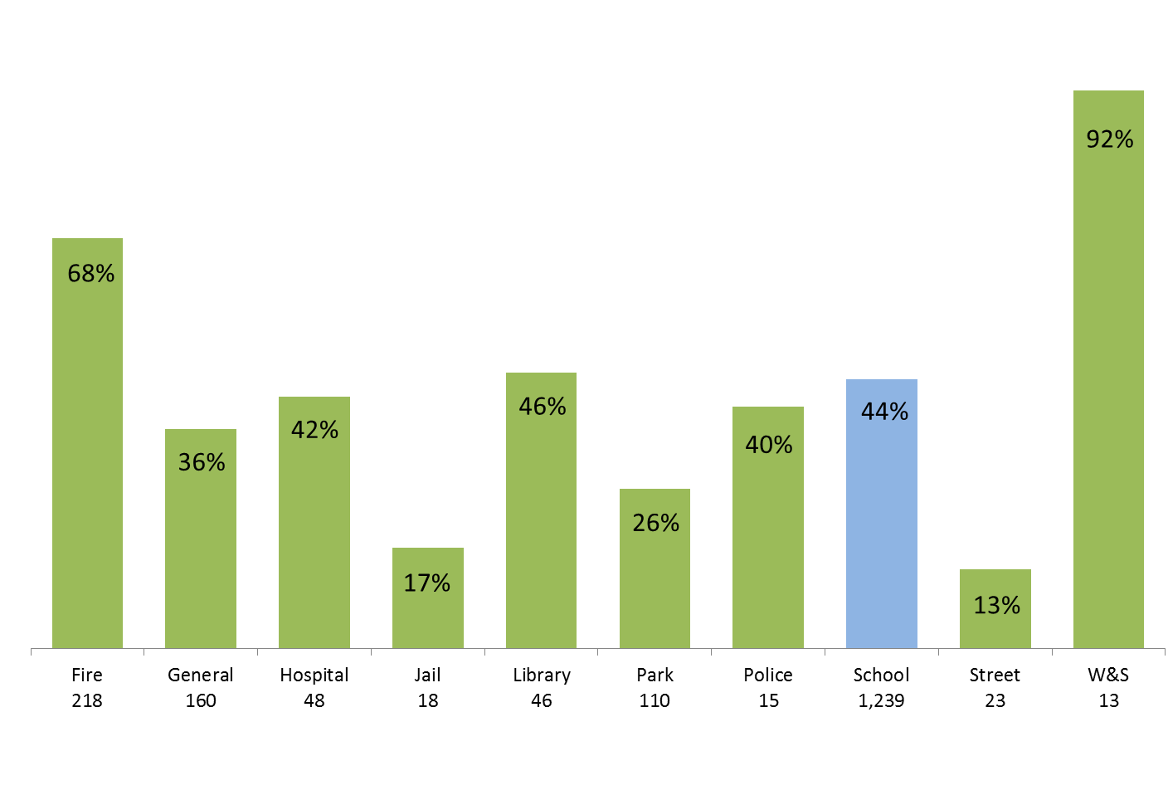
Bond Issues Passed by Purpose-Washington State (Years 1992 through 2015-inclusive)

Slide 8
2016 Special Election and Resolution Filing Dates
The 2016 special election dates and ballot resolution filing deadlines pursuant to the Revised Code of Washington (“RCW”) are listed below for your information.⁽¹⁾ These are the dates permitted under current law, which are subject to change by the Legislature.
Election Date 2016 | Resolution Filing Deadline ⁽²⁾ | Approximate Date Ballots are Mailed ⁽³⁾
February 9, 2016 | December 11, 2015 | January 22, 2016
April 26, 2016 | February 26, 2016 | April 8, 2016
August 2, 2016 (Primary) | May 13, 2016 | July 15, 2016
November 8, 2016 (General) | August 2, 2016 | October 21, 2016
(1) This data is for informational purposes only and does not take the place of local, state or federal laws. Specific RCW information can be found at: http://www.secstate.wa.gov/elections/election_laws.aspx.
(2) Some dates may have been adjusted to reflect the business day prior to actual resolution filing date, according to RCW 29A.04.330, if falling on a weekend.
(3) Applies to both mail and absentee ballots. Absentee ballots are required to be mailed no later than 18 days prior to the election date. RCW 29A.40.070.
Source: Washington Secretary of State’s Office, Elections and Voting website.

Slide 9
PDC Overview
Initiative Measure No. 276 was passed by a vote of the people in the State of Washington in 1972. It was composed of two distinct parts, Campaign Disclosure and Contributions, now codified in chapter 42.17A RCW, and the Public Records Act, now codified chapter 42.56 RCW.
The initiative was challenged and upheld by the Washington State Supreme Court in Fritz v. Gordon 83 Wn.2d 275 (1974).

Slide 10
Use of Public Office or Agency Facilities in Campaigns
The specific provision of this act that concerns us today is found in RCW 42.17A.555 (formerly RCW 42.17.130) which states in part as follows:
No elective official nor any employee of his or her office nor any person appointed to or employed by any public office or agency may use or authorize the use of any of the facilities of a public office or agency, directly or indirectly, for the purpose of assisting a campaign for election of any person to any office or for the promotion of or opposition to any ballot proposition.

Slide 11
RCW 42.17A.555
Facilities of a public office or agency include, but are not limited to, use of stationery, postage, machines, and equipment, use of employees of the office or agency during working hours, vehicles, office space, publications of the office or agency, and clientele lists of persons served by the office or agency.

Slide 12
Public Facilities
“Facilities of a public office or agency” has been defined by case law and administrative interpretations as including the following:
School buildings, property and structures;
School mailboxes and school email (See Herbert v. Washington State Public Disclosure Com’n, 136 Wn. App. 249 (2006), see also PDC Case. No. 13-033);
School employees (See Crisman v. Pierce County Fire Protection District No. 21, 115 Wn. App. 16 (2002)); and
School vehicles, equipment and uniforms (See PDC Case No. 12-125)

Slide 13
Examples of “Use of Facilities”
“Use of such facilities” has been found to include:
Use of city email account to reply to email query concerning upcoming campaign kick-off events for election matters (PDC Case. No. 13-033);
Taping an advertisement opposing an initiative using a police vehicle and wearing a public entity purchased uniform (PDC Case No. 12-125);
Using a public entity’s email to discuss, strategize concerning candidates and initiatives (PDC Case. Nos. 12-165 and 13-032)

Slide 14
RCW 42.17A.555
This provision is applicable to:
Elected officials;
Any employee of an elected official; and
Any person appointed to or employed by any public office or agency

Slide 15
WAC 390-05-271
These restrictions are limited. See WAC 390-05-271 which states:
(1) RCW 42.17A.555 does not restrict the right of any individual to express his or her own personal views concerning, supporting, or opposing any candidate or ballot proposition, if such expression does not involve a use of the facilities of a public office or agency.
(2) RCW 42.17A.555 does not prevent a public office or agency from
(a) making facilities available on a nondiscriminatory, equal access basis for political uses, or
(b) making an objective and fair presentation of facts relevant to a ballot proposition, if such action is part of the normal and regular conduct of the office or agency.

Slide 16
Exceptions
RCW 42.17A.555 contains two express exceptions:
Action taken at an open public meeting by an elected legislative body to express a collective decision, or to actually vote to support or oppose a ballot proposition.
The exception requires that the required notice for the meeting includes the title and number of the ballot proposition and provides members of the body and the public an approximately equal opportunity for the expression of an opposite view. (See AGO 2005 No. 4 construing the term “elected legislative body.”)
A statement by an elected official in support of or in opposition to any ballot proposition at an open press conference or in response to a specific inquiry.
Activities which are part of the normal and regular conduct of the office or agency are also exempt.

Slide 17
What is “Normal”?

Slide 18
Normal and Regular Conduct
“Normal and regular conduct” has been defined as follows (WAC 390–05–273):
Normal and regular conduct of a public office or agency, as that term is used in the proviso to RCW 42.17A.555, means conduct which is:
(1) lawful, i.e., specifically authorized, either expressly or by necessary implication, in an appropriate enactment, and
(2) usual, i.e., not effected or authorized in or by some extraordinary means or manner.
No local office or agency may authorize a use of public facilities for the purpose of assisting a candidate's campaign or promoting or opposing a ballot proposition, in the absence of a constitutional, charter, or statutory provision separately authorizing such use.

Slide 19
Normal and Regular Conduct
“Normal and regular conduct” has been defined as follows:
PDC Declaratory Order No. 2 identifies that the power of legislative bodies of municipal organizations to research and provide information, or to submit questionnaires to establish budget priorities as examples of “normal and regular conduct.”
RCW 28A.320.090 provides the authority to explain its instructional program, operation and maintenance of the school district. See also PDC Declaratory Order No. 14.
The agency or official must show that the activity is not a one-time occurrence during an election campaign but is part of a course of conduct which is usual and customary for that official or agency.

Slide 20
Normal and Regular Conduct
Historically, the PDC has routinely advised and held that with respect to election-related publications, one district-wide objective and fair representation of the facts per ballot measure is appropriate. Normal and regular conduct that is broader in scope and number could expand this.

Slide 21
Cannot Influence Outcome
Permitted Preparation and Distribution of Information
The board of directors of a school district may authorize expenditure of public funds to prepare and distribute information to the general public in order to explain the instructional program, operation, and maintenance of the schools within the district.
While the district is authorized to inform the community of the needs of the district and of the students, it is not authorized to do so in such a way that would influence the outcome of an election.

Slide 22
Promoting, Opposing or Assisting Campaigns
“Promoting, opposing or assisting campaigns” has been defined as follows:
Information containing promotional tenor and tone, including:
“Teachers will be laid off if levy fails”;
“Voters have great opportunity to do something special for children”;
“Everyone’s future depends on the education of our children”;
“If bond fails, students will be less prepared for success”.

Slide 23
Promoting, Opposing or Assisting Campaigns
Other promotional activities include:
Coordinating the scheduling of events and speakers with campaign committee members;
Preparing and providing materials to campaign committees at no cost to the campaign committee;
Storing campaign committee materials at school; and
Sending levy or bond information in district newsletters to registered voters rather than parents or all residents; i.e., targeting for promotional purposes.

Slide 24
Promoting, Opposing or Assisting Campaigns
Other promotional activities include:
Using survey results specifically to market bond and levy propositions (“82 percent of teachers said passing bond was priority” included in school newsletter);
Using survey to find methods of how to convince voters to vote “yes”;
Providing unbalanced information about impact or speculating as to consequences of passage or failure;
Focusing on negative impacts only; and
Using communication tools only for promotion of a bond or levy where not used for communication prior to the bond or levy.

Slide 25
Non-Violations
The following were found to not constitute a violation of RCW 42.17A.555:
Statements made during an informational Webcast concerning a replacement levy measure. The Webcast contained a question and answer period and in response to specific questions, an administrator opined on the motivation of a caller as being willing to hurt kids due to hostility to employees. The PDC found that the comments “appeared to be an attempt to address questions raised by an inquiry. . . which is a permissible use of district resources.” (PDC Case No. 12-157).

Slide 26
Non-Violations
Other circumstances not considered violations:
Where a party drove a vehicle owned by the municipality to a candidate interview conducted by a private association. The vehicle was an assigned “take-home” vehicle. The driver was a candidate for office. The vehicle was driven for municipal purposes before and after the interview. The PDC found that it was “normal and regular for him to drive the city vehicle everyday to conduct city business, which he did both before and after his personal appointment.” (PDC Case No. 12-143).

Slide 27
Non-Violations
Other circumstances not considered violations:
Where a school district, prior to a ballot issue placed on the ballot by the school district, held open houses by naming the school available to community groups and helping to plan two open houses staffed by volunteers including teachers, staff and community members. The school district had a practice of announcing school events on its reader board and advertised the open houses on its reader board. School district officials denied that the campaign group influenced the decision to hold the open houses. The PDC found that the open houses, and the use of the school for the open houses, did not constitute a “prohibited use of public facilities to promote Proposition 1.” (PDC Case No. 08-111).

Slide 28
Non-Violations
Other circumstances not considered violations:
Where a school official, on her own time using her own computer, sent invitations to an open house and included her school district telephone number in the email as a contact number for people with questions because the district was sponsoring the open house. A post card inviting people to the open house also contained the school phone number. The school official also used the school’s email to apologize for naming all recipients in her original invitation. The school district also provided a list to the campaign committee which was compiled in the ordinary course of business as a result of a public record request.

Slide 29
Non-Violations
Other circumstances not considered violations:
The PDC found:
The release of the list of parents’ names, street addresses, phone numbers and email addresses did not constitute a prohibited use of school district facilities to promote Proposition 1.
Publishing a message on the school district website that provided information about Proposition 1, as well as publishing the same information in the school districts newsletter was found to be “normal and regular conduct” and a “fair and objective presentation of facts relevant to the ballot proposition” was not a prohibited use of public facilities.

