Slide 1
WSSDA’s Weekly Legislative Update
February 3, 2017
Notes:
Welcome slide

Slide 2
Welcome! Please type your name, school district / organization, and role into the chat box!
Webinar Materials (3 documents):
Committee Meeting Schedules:
Week 3 recap (pdf)
Week 4 preview (pdf)
Bill Watch List, 1/27/17 (coming this afternoon) (pdf)
Logistics
Webinar materials (Leg Update Web Page)
http://wssda.org/Legislative/LegislativeUpdates.aspx
Q&A / Comment process
Chat and Question Boxes
Phones on mute
Webinar recordings & ppt materials (Leg Rep Web Page)
http://wssda.org/Legislative/SchoolBoardLegislativeRepresentatives.aspx
Introductions
WSSDA Staff
Tim Garchow, WSSDA Executive Director, t.garchow@wssda.org
Jessica Vavrus, Gov’t Relations Director, j.vavrus@wssda.org and/or 360-890-5867
Tricia Kimbrough, Legislative Coordinator, t.kimbrough@wssda.org
Notes:
Jessica

Slide 3
WSSDA’s Weekly Legislative Update Webinars: Purpose and Audience
Who:
School Board Legislative Representatives
Other interested school directors
What:
Timely legislative and bill / issue updates
Summary of the week’s activities and preview to hearings for the coming week
Orientation to the legislative process, bill tracking, and web-based resources
Why:
To engage and empower school board legislative representatives to work with their boards and communities in legislative issues that matter the most
Where/When:
Every Friday during the Legislative Session, at 12:00
Register here: http://wssda.org/Legislative/SchoolBoardLegislativeRepresentatives.aspx
Recording will be posted to the web site

Slide 4
Why are YOUR legislative partnerships & priorities important?
1.1 million
K-12 Students
295
School districts
147
Legislators
1,477
YOU
YOU’VE been entrusted in your community
Power in numbers and voice
How can we better engage / involve Leg. Reps across the state??
Decisions made in Olympia DO and WILL affect your district

Slide 5
Today’s Focus
Updates & Actions
Bill / Issue Updates
Bill Watch – bills of interest
Week 5 Preview
Legislative Resources
Key Dates
Foundations:
Digging into education budget proposals
Tracking & providing input
Last Week’s Topics (check out the recording online!):
Updates & Actions
Foundations:
Unpacking and understanding bills

Slide 6
Bill/Issue Updates Schedules

Slide 7
Week 4 Recap
Bill / Issue Actions & Highlights
Ed Funding Proposals
Levy Lid Delay – HB 1059 public hearing in Ways & Means
SB 5607 – public hearing, executive session, and Senate passage
School District Liability Bill – SB 5505
1/31 Testimony (school attorneys, superintendents)
Implications & necessary next steps (need exec. session)
Student Health/Nutrition: HB 1508, HB 1551 (facilities)
Truancy Bills (comparison)
SB 5293 (Darnielle)
SB 5563 (Fortunato)
HB 1170 (Orwall)

Slide 8
Week 4 Recap – Bills to Watch
Bill Watch List, updated 2/3/17
Introductions of interest:
Simple Majority in Bond Elections
HB 1778 (Stonier)
HB 1779 (Muri) – November only
SB 5076 (Mullet)
Federal Forest Revenue Deductions: HB 1393 / SB 5664
SBE / OSPI Governance Roles: HB 1886 / SB 5673
Student Supports:
Learning Assistance Program: HB 1511
Homeless Supports: SB 5656 (ending homelessness)
Language Access (HB 1451) ; Dual Language (HB 1445)

Slide 9
Week 5 Committee Meeting Schedules
Feb. 6 – 10, 2017 Schedule – as of 2/3/17
See green shading on pdf schedule for KEY meetings
Ways to engage:
Email and call your legislators regarding bills that are scheduled for public hearing and/or executive sessions
Come to Olympia – to testify! (not just to watch ☺)

Slide 10
Key Session Dates
Feb. 17 – House Policy Committee Cutoff
Feb. 24 – Fiscal Committee Cutoff
March 8 – House of Origin Cutoff
March 29 – Policy Cutoff – Opposite House
April 4 – Fiscal Cutoff – Opposite House
April 12 – Opposite House Cutoff
April 23 – Last Day of 105-day Regular Session

Slide 11
Law-Making Process
Chamber #1
Introduced
Hearing
Comm. Vote
Rules (2-3 votes)
Floor Calendar
Floor Vote
Chamber #2
Introduced
Hearing
Comm. Vote
Rules (2-3 votes)
Floor Calendar
Floor Vote
Reconciliation
Conference agreement
Floor vote
Floor vote
Governor
Partial/ Full Veto
Interpretive statement

Slide 12
WA State Legislature Resources
WA State Legislature
Legislative Committee Information - Find out who is on what committee and what their meeting agendas include.
Schedules: To find more details on the Committee Meeting agendas, visit the House Committee or Senate Committee Web sites and click on the Committee you are interested in.
Bill Information and Tracking - From these pages you can follow the bills you are most interested in and also provide comments on bills.
TVW - TVW is a great resource where you can watch hearings live, or go to the Archives to view past hearings of interest, just select the date and committee.

Slide 13
foundations
Digging into Budget Proposals

Slide 14
Navigating Education Budget Proposals: Making meaning & providing input
Bills / Proposals “in-play”:
Governor Inslee’s 2017-19 Education Budget
Senate Majority Coalition Caucus (R) Proposal
Summary
School district and taxpayer impact spreadsheets
School District Total Amounts
Per Student Amounts
Funding & Taxpayer Impacts
SSB 5607 Bill Report
Democratic Caucus Proposal
Summary & Cost Estimates
HB 1843
Public hearing scheduled for BOTH bills:
MONDAY 2/6
House Appropriations, 3:30pm

Slide 15
Participating & Providing Input
House Appropriations Committee
In person?
Provide written testimony for WSSDA staff to share?
Legislator Contacts
Ways to engage:
Email and call your legislators regarding bills that are scheduled for public hearing and/or executive sessions
Come to Olympia – to testify! (not just to watch ☺)

Slide 16
Things to remember
Looking Ahead

Slide 17
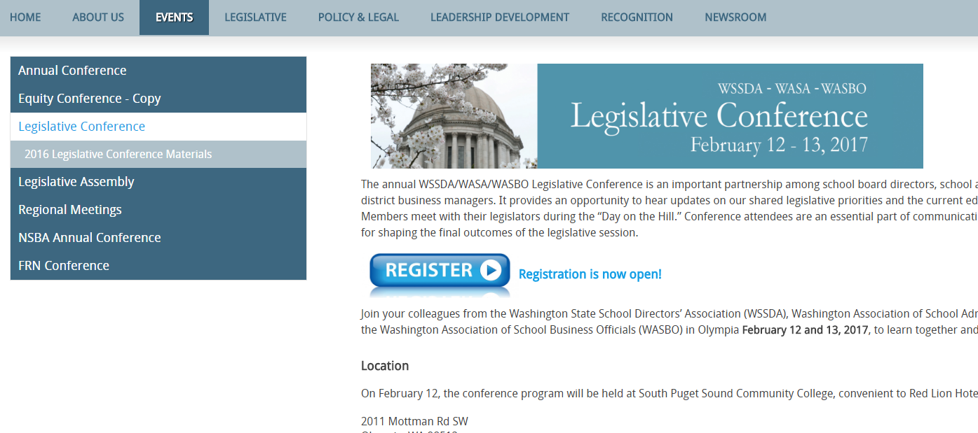
Upcoming Events
Annual Legislative Conference & Day on the Hill
February 12-13, 2017 in Olympia
Registration Open Now!
http://wssda.org/Events/LegislativeConference.aspx
Sponsored by: WSSDA/WASA/WASBO

Slide 18
Next Week’s Webinar
Foundations:
More on reviewing & communicating input on bills
Why are dates important?
Updates and Actions:
Week 3 recap
Bill and issue updates
Week 4 preview

Slide 19
2017 WSSDA Legislative Priorities http://wssda.org/Legislative/OurPrioritiesPositions.aspx
2016 Legislative Assembly (September)
95 school district board delegates
Deliberated 62 legislative positions
2017 Priorities (Top 20 rankings from Leg. Assembly)
Invest in our students
Funding, levies, revenue
Support our schools
Facilities, school construction & siting
Public records requests
Attract and retain quality staff
Compensation
Bargaining
Teacher recruitment, retention, professional development
Joint Association Ed Funding Priorities
Prioritized To-Do List for Education Funding

Slide 20
WSSDA Resources for learning and communications
WSSDA’s Legislative Representative Web Page – this is a new web page just for school district board legislative reps. It is where you can register for the weekly updates and also access quick links for legislative activities.
WSSDA Legislative Updates - Includes weekly committee schedules, bill watch lists, and WSSDA’s legislative updates during the legislative session
WSSDA Advocacy Resources - Organized by WSSDA position categories

Slide 21
WSSDA Resources, cont’d
WSSDA opportunities:
Know and Access your Legislative Committee DA Representatives (elected at Annual Conference)
Participate in key statewide events:
WSSDA Legislative Assembly – set WSSDA’s legislative priorities (Sept)
Legislative Conference and Day on the Hill in Olympia (with WASA / WASBO) (Jan/Feb)
Serve as your board’s Legislative Representative, discuss issues with your board
Attend WSSDA Regional meetings in the Spring or Fall
Tune-in:
Sign-up for WSSDA eClips
During session: weekly Legislative Updates to members;
Social media (Facebook & Twitter):You don’t have to have an account to follow “tweeters” during the session!
Follow Jessica or #wssdaleg and also check out #WAedu and #WAleg

Slide 22
Questions / Comments?
Use the Chat/Question Box
Or
Contact: Jessica Vavrus, Gov’t Relations Director, j.vavrus@wssda.org ; 360-890-5867

Slide 23
Thank you!
Talk to you next week!

