Slide 1
WSSDA’s Weekly Webinar: Week 13 Update
April 7, 2017
Notes:
Welcome slide

Slide 2
Welcome! Please type your name, school district / organization, and role into the chat box!
Webinar Materials (3 documents):
PowerPoint presentation (ppt)
Legislative Schedules:
Week 13 review (pdf)
Week 14 preview (pdf)
Bill Watch List, updated 3/31/17
Logistics
Webinar materials (Leg Update Web Page)
http://wssda.org/Legislative/LegislativeUpdates.aspx
Q&A / Comment process
Chat and Question Boxes
Phones on mute
Leg. Update Webinar recordings & ppt materials (Leg Rep Web Page)
http://wssda.org/Legislative/SchoolBoardLegislativeRepresentatives.aspx
Introductions
WSSDA Staff
Jessica Vavrus, Gov’t Relations Director, j.vavrus@wssda.org and/or 360-890-5867
Tricia Kimbrough, Legislative Coordinator, t.kimbrough@wssda.org
Notes:
Jessica

Slide 3
WSSDA’s Weekly Legislative Update Webinars: Purpose and Audience
Who:
School Board Legislative Representatives
Other interested school directors
What:
Timely legislative and bill / issue updates
Summary of the week’s activities and preview to hearings for the coming week
Orientation to the legislative process, bill tracking, and web-based resources
Why:
To engage and empower school board legislative representatives to work with their boards and communities in legislative issues that matter the most
Where/When:
Every Friday during the Legislative Session, at 12:00
Register here: http://wssda.org/Legislative/SchoolBoardLegislativeRepresentatives.aspx
Recording will be posted to the web site

Slide 4
Today’s Focus
Updates & Actions
Key Dates
Process check
Weekly Recap & Week Ahead Preview
Key public hearings
Bill / Issue updates
Things to watch
Deeper Dive & Foundations:
Issue areas for continued engagement
Budget Updates
Capital
Operating

Slide 5
Legislative updates: Week 13
Weekly recap Bill/Issue Updates the week ahead

Slide 6
Key Session Dates
Feb. 17 – House Policy Committee Cutoff
Feb. 24 – Fiscal Committee Cutoff
March 8 – House of Origin Cutoff
March 29 – Policy Cutoff – Opposite House
April 4 – Fiscal Cutoff – Opposite House
April 12 – Opposite House Cutoff
April 23 – Last Day of 105-day Regular Session
Note: these deadlines are important to help “weed out” bills; but they also can get in the way…

Slide 7
Law-Making Process – where are we now?
Chamber #1
Introduced
Hearing
Comm. Vote
Rules (2-3 votes)
Floor Calendar
Floor Vote
Chamber #2
Introduced
Hearing
Comm. Vote
Rules (2-3 votes)
Floor Calendar
Floor Vote
Reconciliation
Conference agreement
Floor vote
Floor vote
Governor
Partial/ Full Veto
Interpretive statement
Through 4/12 (Opposite House bills):
Floor Votes
Conference agreements

Slide 8
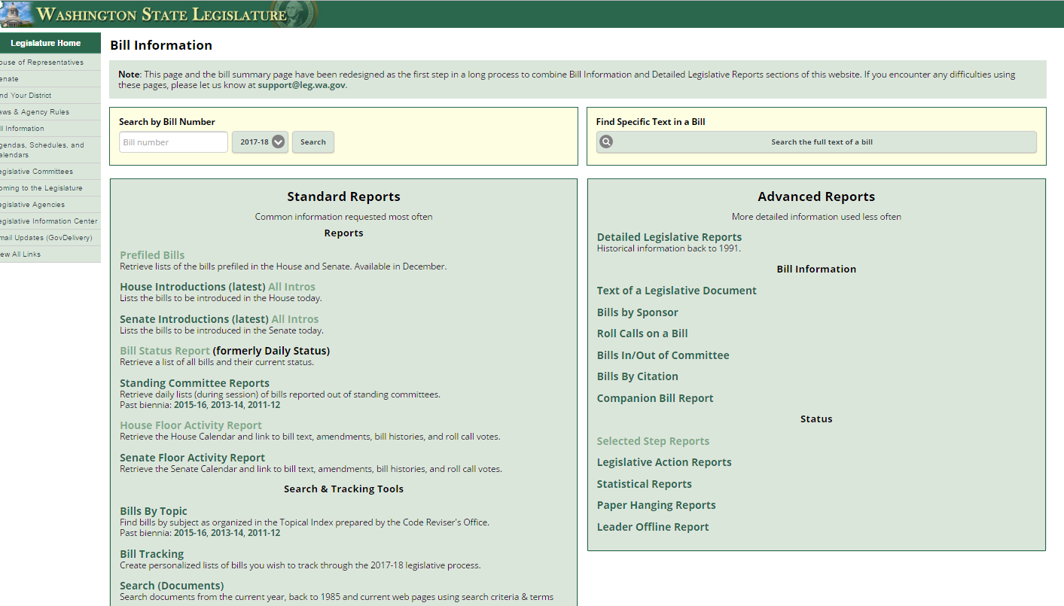
What is the status of XX bill?
Bill Information and Tracking - From these pages you can follow the bills you are most interested in and also provide comments on bills.
Bill Information page provides more in-depth options for learning more about what’s happening
Roll Call votes and other Bill details
Floor Activity Status
House
Senate

Slide 9
Understanding “dead” bills & how to revive
During Regular Session:
Necessary To Implement the Budget (“NTIB”)
Fiscal Impacts – with accompanying bills
Budget Proviso
Budget Provisos (some with/without $)
During Special Session:
If still in original House – bills stay where they last ended
If on the Floor Calendar – bills revert back to Rules
If in opposite House – bills revert back to the House of Origin (Rules)
Leadership generally agree on what “types” of bills continue on for deliberation through the Special Session.

Slide 10
Week Schedule, Participating & Providing Input
April 3 - 7, 2017 – as of 3/30/17
April 10 -14, 2017 – ways to stay connected
Floor Activity Status House Senate
TVW Channels: House Senate
Twitter: #waleg
Rules Committees (sign up for email or RSS alerts to see what bills are moving to the Floor)
House
Senate
Participating & Providing Input:
Legislator Contacts
Includes worksheets with committee member and staff listings

Slide 11
Week 13 Updates: Highlighted Bill / Issue Actions
Key: H = Public Hearing held// H = Public Hearing scheduled// ES = Executive Session scheduled// PC/FC = Passed/Failed Committee // R = Rules // FL = Floor Calendar// PS/FS = Passed/Failed Senate// PH/FH = Passed/Failed House // PL = Passed Legislature (awaiting Gov action) // SL = Session Law
Learning (WSSDA Position Category 1)
Curriculum / Instruction:
SSB 5064 (students’ freedom of expression) ES Dead
2SSB 5236 (civic learning public-private partnership) ES Dead
ESSB 5449 (digital citizenship, media literacy, internet safety) PH
ESHB 1481 (driver education uniformity) FL
Assessments / Graduation Requirements:
SB 5891 (Delaying requirement of science high school assessment as graduation requirement until the Class of 2021) PS
SB 5639 (Alternative student assessments) **House Ed. Striking Amendment replaced text of this bill with that of HB 1046 (Delinking ELA, Math, Science high school assessments as graduation requirements) R
SHB 1235 (Physical Education Assessments and Reporting) PL
Student Supports & Student Nutrition:
SHB 1508 (Student Nutrition/Breakfast after the Bell) R
EHB 1551 (equipment assistance grant program to enhance student nutrition in public schools) Dead – but in H Cap. Budget
SHB 1618 (Family and community engagement coordinators) Dead
Dual Language / Bilingual Ed: SHB 1445 (Dual language in early learning & K12) FL
Truancy:
2SHB 1170 (Truancy reduction) R
ESSB 5293 (court-based and school-based efforts to promote attendance and reduce truancy) R
Homeless / Foster Youth:
SSB 5241 (educational success / credit attainment) PL
SHB 1816 (homeless youth information sharing) ) FL
SHB 1867 (extended foster care transitions) ) FL
SHB 1641 (homeless youth health care) FL

Slide 12
Week 13 Updates: Highlighted Bill / Issue Actions
Key: H = Public Hearing held// H = Public Hearing scheduled// ES = Executive Session scheduled// PC/FC = Passed/Failed Committee // R = Rules // FL = Floor Calendar// PS/FS = Passed/Failed Senate// PH/FH = Passed/Failed House // PL = Passed Legislature (awaiting Gov action) // SL = Session Law
Teaching (WSSDA Position Category 2)
Certification
2SHB 1341 (professional certification for teachers/administrators) FL
EHB 1654 (explicit alternative routes for teacher certification programs) PL
Recruitment / Retention
HB 1445 (dual language in K-12 ed) FL
SB 5712 (bilingual ed workforce) Dead – but in S Budget
Education Support Associates / Student Supports:
SSB 5142 (Educational interpreters) PL
SB 5325 R / SHB 1346 FL (Nurse in a school setting)
ESHB 1115 FL / SB 5070 R (Paraeducators)
Keep an eye on:
HB 1827 Referenced H-Budget (broad bill to address many components related to Teacher Recruitment, Educator Retention, Evaluation of Educator Effectiveness, Educator Certification, Incentives and Assistance for Educators)
Considered Necessary to Implement the Budget (NTIB)

Slide 13
Week 13 Updates: Highlighted Bill / Issue Actions
Key: H = Public Hearing held// H = Public Hearing scheduled// ES = Executive Session scheduled// PC/FC = Passed/Failed Committee // R = Rules // FL = Floor Calendar// PS/FS = Passed/Failed Senate// PH/FH = Passed/Failed House // PL = Passed Legislature (awaiting Gov action) // SL = Session Law
Leadership (WSSDA Position Category 3)
SHB 1279 (School Safety Drills) R
SSB 5404 (Sunscreen in Schools) R
2SSB 5107 (Early Childhood Ed/Assistance) FL
Governance (WSSDA Position Category 4)
EHB 1017 (School Siting) R
HB 1800 (Voting Rights Act) Dead
SB 5068 (Voting Rights Act – cities, towns, code cities, counties – DOES NOT CURRENTLY INCLUDE SCHOOL DISTRICTS) Dead
HB 1595 (public records request costs) FL
HB 1594 (improving public records administration) FL
HB 1060 (Medical Marijuana in schools) FL
SHB 1886 (SBE / OSPI Governance Accountability Roles) PL
SSB 5641 (school district class naming) R
Keep an eye on:
SB 5726 (School Employee Health Care Benefits -Requires that school and educational service districts provide based health care to employees through the Public Employee Benefits Board) NTIB

Slide 14
Week 13 Updates: Highlighted Bill / Issue Actions
Key: H = Public Hearing held// H = Public Hearing scheduled// ES = Executive Session scheduled// PC/FC = Passed/Failed Committee // R = Rules // FL = Floor Calendar// PS/FS = Passed/Failed Senate// PH/FH = Passed/Failed House // PL = Passed Legislature (awaiting Gov action) // SL = Session Law
Funding & Allocations (WSSDA Position Category 5)
Education Policy & Budget Bills: ALL NTIB
Policy Bills
Overall: SSB 5607 PS + ESSB 5875 PS, ESHB 1843 PH, SB 5825 H
CTE: SB 5853 R
Learning Assistance Program modifications: SSB 1511 (components could inform budget discussions)
Budget Bills-
House Budget: ESSB 5048 PH, (SHB 1067 became a striker to SSB 5048 – see fiscal.wa.gov for progression)
Senate Budget: ESSB 5048 (through 3/31)
Levy Lid Delay - ESB 5023 (Levy Lid Delay) SL
SB 5664 (Federal Forest Revenue Deductions) H – NOTE: NOT included in either budget as proviso
Note: Secure and Rural Schools Federal funding was not reauthorized by Congress, thus increasing the importance of this bill (or proviso) given the large reduction of federal forest revenue coming to states as a result.
Operating Budget Revenue Bills:
Operating Budgets: SSB 5048 (Senate proposal); SHB 1067 (House proposal)
Revenue Bills: SB 5111 (Capital gains) FS; SB 5113 FL / HB 1550 (B&O modifications); SB 5127 FL (Carbon tax); HB 1549 / SB 5112 (eliminate tax preferences); HB 2186 (full House revenue compilation bill) R; HB 2164/ HB 2163 (Revenue T.O.)
Capital Facilities / Capital Budget
SB 5702 (improving state funding for school construction, modernization, and asset preservation) H
SB 5453 (school construction grants for small, rural schools) PC
SSB 5644 (skill center facility maintenance) R
2SHB 1777 (financing early learning facilities) ES
HB 1203 (Exempting school districts from the state portion of sales and use taxes on school construction)
Bond Bills: SB 5090 / HB 1080 (Concerning state general obligation bonds and related accounts)
Capital Budget Bills: SB 5086 PS / HB 1075 ES, and HB 2170 (Capital Budget T.O.)
Miscellaneous - See current WSSDA Bill Watch List (updated 3/30/17)

Slide 15
Deeper dive & foundations
Ed Funding Proposals & information sharing
Where we are in the process

Slide 16
Past Deep Dive Topics
Budget Proposals
Senate operating budget proposal – 3/27/17
Teacher Shortage Issues (recruitment, retention, certification) – 3/17/17
School Siting (building schools outside of Urban Growth Areas) – 3/10/17
High School Assessment Graduation Requirements – 3/10/17
Education Funding Issues – 3/10/17
Understanding and Navigating Bills / Legislative Process – January & February webinars

Slide 17
Issues to watch/stay engaged in (non-budget)
Teacher Shortages / Professional Certification (HB 1341) – HB 1827
HB 1445 (dual language instruction)
SB 5712 (bilingual educator workforce)
School siting – HB 1017
HS Assessment Graduation Requirements (HB 1046 (ELA, Math, Science) turned into SSB 5639 / SB 5891 (science delay only)
Public Records – HB 1595 (cost recovery) and HB 1594 (public records administration)

Slide 18
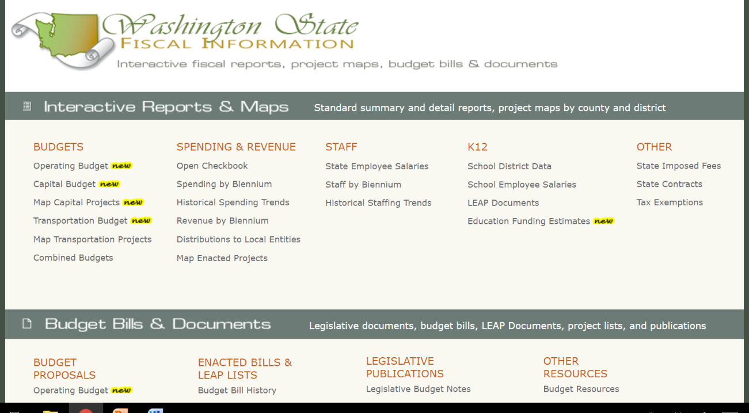
Navigating Fiscal Resources
Washington State Fiscal Information Web portal
(http://fiscal.wa.gov/default.aspx)
Budget & bill documents
Comparison tools
Analysis documents (new)

Slide 19
2017-19 Capital Budget Proposals
SHB 1075- House proposed capital budget
$1.095 billion for K-12 (represents 35% of state capital budget (up from 26%))
Not much total difference between House and Senate – different approaches though
Overall + big issues to deal with
K-3 Class Size grants
Funding SCAP commitments due to increased bond passage
Square footage allocation – increase now? Or….?
Rural school grants
Funds for fixing water fixtures found problematic in required testing (related to operating budget)
Task force and citizen advisory to map out the “plan”?
Resources:
Capital budget bill documents
SHB 1075 “Summary” (p. 12, 21)
SSB 5086 “Summary” (pp.7 and 15)
Capital budget comparison charts
House Capital Budget Committee hearing & executive session
Process for Floor deliberations + next step negotiations

Slide 20
Operating & Education Budget Next Steps
Operating Budget Discussions:
Senate Budget (SHB 5048) debated in House 3/30 & 3/31
House Budget (SHB 1067) to be discussed/voted on by House on 3/31 (?)
Education Budget Considerations:
“Sticky” Issues:
Funding model
Salary allocation approach (staff mix; categorical funding; student-centered funding)
Poverty measures (FRL vs. Census)
Revenue
Collective Bargaining
Discussions among H and S education leads
Key Legislators: Senators Braun, Rivers, Rolfes, Billig, Braun, Fain; Representatives Harris, Taylor, Lytton, Sullivan
1:1 meetings with staff and legislators continue
Weekly WSSDA Legislative Committee meetings
Share your thoughts with WSSDA staff and your Legislative Committee D.A. Representatives
NOW WHAT??
Policy makers are in the midst of the fundamental discussions and negotiations
Districts should:
Use the district impact spreadsheets to identify impacts for your district – communicate good things and concerns (keep WSSDA in the loop!)
Review current Education Funding Recommendations & Discussion Points
Add your district’s input to the WASA/WSSDA Ed Funding Survey data
Email Jessica at j.vavrus@wssda.org for the link!
Resource: WSSDA’s 2017 Education Funding Proposal Web page

Slide 21
Upcoming events
Regional Meetings
Next Week’s Webinar
Legislative Assembly Preparations

Slide 22
Upcoming Events
WSSDA Spring Regional Meetings
Started last week!
Legislative update content – what would you like included for your region?
Next week’s webinar – and beyond
Updates and Actions:
Weekly recap
Bill and issue updates
Deeper Dives:
Education Funding Plan / Budget Updates
Capital Budgets

Slide 23
Upcoming Legislative Assembly: Get Involved: Learn about the process and WSSDA’s current legislative positions
Review WSSDA’s informational webinar (March 31)
Posted to web: http://wssda.org/Events/LegislativeAssembly.aspx
Review WSSDA’s 2017 Legislative Positions and Priority Ranking
http://wssda.org/Events/LegislativeAssembly.aspx
Establish the top priorities your Board cares about
Review WSSDA positions in light of your Board’s priorities
Which positions should continue?
Are there positions missing on important issues?
Notes:
Jessica

Slide 24
Upcoming Legislative Assembly: Get Involved: Submit a proposal and/or Attend Assembly
Consider submitting a new or returning position proposal
Collaborate with other districts - Sometimes more than one district has a similar issue they wish to address with a legislative proposal so it is not uncommon for districts to come together in submitting a collaborative proposal.
Proposal Submission – Review and Refinement
WSSDA staff and the Legislative Committee will review all proposals and synthesize for the Assembly (June and July)
Attend the Assembly!
Review materials in advance so you’re ready
Participate in “New to Assembly” meetings & Director Area Caucus Meetings
Notes:
Jessica

Slide 25
2017 Legislative Assembly: Key Dates
March 31 – Proposal solicitation begins
June 2 – Deadline for proposal submissions
June 7 – Registration for 2016 Legislative Assembly and lodging at the Southcenter DoubleTree Hotel (SeaTac)
September 22 & 23 – 2017 Legislative Assembly, SeaTac
Notes:
Jessica

Slide 26
resources

Slide 27
WA State Legislature Resources
WA State Legislature
Bill Information and Tracking - From these pages you can follow the bills you are most interested in and also provide comments on bills.
Legislative Committee Information - Find out who is on what committee and what their meeting agendas include.
Schedules: To find more details on the Committee Meeting agendas, visit the House Committee or Senate Committee Web sites and click on the Committee you are interested in.
TVW - TVW is a great resource where you can watch hearings live, or go to the Archives to view past hearings of interest, just select the date and committee.

Slide 28
WSSDA Resources for learning and communications
New: 2017 Education Budget Proposal web page – includes general information about proposals along with side-by-side comparisons
WSSDA’s Legislative Representative Web Page – this is a new web page just for school district board legislative reps. It is where you can register for the weekly updates and also access quick links for legislative activities.
WSSDA Legislative Updates - Includes weekly committee schedules, bill watch lists, and WSSDA’s legislative updates during the legislative session
WSSDA Advocacy Resources - Organized by WSSDA position categories

Slide 29
WSSDA Resources, cont’d
WSSDA opportunities:
Know and Access your Legislative Committee DA Representatives (elected at Annual Conference)
Participate in key statewide events:
WSSDA Legislative Assembly – set WSSDA’s legislative priorities (Sept)
Legislative Conference and Day on the Hill in Olympia (with WASA / WASBO) (Jan/Feb)
Serve as your board’s Legislative Representative, discuss issues with your board
Attend WSSDA Regional meetings in the Spring or Fall
Tune-in:
Sign-up for WSSDA eClips
During session: weekly Legislative Updates to members;
Social media (Facebook & Twitter):You don’t have to have an account to follow “tweeters” during the session!
Follow Jessica or #wssdaleg and also check out #WAedu and #WAleg

Slide 30
In closing….Why are YOUR legislative partnerships & priorities important?
1.1 million
K-12 Students
295
School districts
147
Legislators
1,477
YOU
YOU’VE been entrusted in your community
Power in numbers and voice
How can we better engage / involve Leg. Reps across the state??
Decisions made in Olympia DO and WILL affect your district

Slide 31
Questions / Comments?
Use the Chat/Question Box
Or
Contact: Jessica Vavrus, Gov’t Relations Director, j.vavrus@wssda.org ; 360-890-5867

Slide 32
Thank you!
Talk to you next week!

