Slide 1
WSSDA’s Weekly Legislative Update
WEEK 10: March 17, 2017
Notes:
Welcome slide

Slide 2
Welcome! Please type your name, school district / organization, and role into the chat box!
Webinar Materials (3 documents):
Legislative Schedules:
Week 10 review (pdf)
Week 11 preview (pdf)
Bill Watch List, to be updated 3/17/17
PowerPoint presentation (ppt)
Logistics
Webinar materials (Leg Update Web Page)
http://wssda.org/Legislative/LegislativeUpdates.aspx
Q&A / Comment process
Chat and Question Boxes
Phones on mute
Webinar recordings & ppt materials (Leg Rep Web Page)
http://wssda.org/Legislative/SchoolBoardLegislativeRepresentatives.aspx
Introductions
WSSDA Staff
Tim Garchow, WSSDA Executive Director, t.garchow@wssda.org
Jessica Vavrus, Gov’t Relations Director, j.vavrus@wssda.org and/or 360-890-5867
Tricia Kimbrough, Legislative Coordinator, t.kimbrough@wssda.org
Notes:
Jessica

Slide 3
WSSDA’s Weekly Legislative Update Webinars: Purpose and Audience
Who:
School Board Legislative Representatives
Other interested school directors
What:
Timely legislative and bill / issue updates
Summary of the week’s activities and preview to hearings for the coming week
Orientation to the legislative process, bill tracking, and web-based resources
Why:
To engage and empower school board legislative representatives to work with their boards and communities in legislative issues that matter the most
Where/When:
Every Friday during the Legislative Session, at 12:00
Register here: http://wssda.org/Legislative/SchoolBoardLegislativeRepresentatives.aspx
Recording will be posted to the web site

Slide 4
Today’s Focus
Updates & Actions
Key Dates
Process check
Weekly Recap & Week Ahead Preview
Key public hearings
Bill / Issue updates
Deeper Dive & Foundations:
Deeper Dives into:
Education Funding Toolkit Resources
Teacher Shortage issues

Slide 5
Weekly recap Bill/Issue Updates the week ahead

Slide 6
Key Session Dates
Feb. 17 – House Policy Committee Cutoff
Feb. 24 – Fiscal Committee Cutoff
March 8 – House of Origin Cutoff
March 29 – Policy Cutoff – Opposite House
April 4 – Fiscal Cutoff – Opposite House
April 12 – Opposite House Cutoff
April 23 – Last Day of 105-day Regular Session
Note: these deadlines are important to help “weed out” bills; but they also can get in the way…

Slide 7
Law-Making Process – where are we now?
Chamber #1
Introduced
Hearing
Comm. Vote
Rules (2-3 votes)
Floor Calendar
Floor Vote
Chamber #2
Introduced
Hearing
Comm. Vote
Rules (2-3 votes)
Floor Calendar
Floor Vote
Reconciliation
Conference agreement
Floor vote
Floor vote
Governor
Partial/ Full Veto
Interpretive statement
Through 3/29 (policy bills) AND 4/4 (fiscal bills) AND 4/12 (Opposite House bills):
Work sessions
Public Hearing
Floor Votes

Slide 8
A refresher: bill basics
Understanding the letter and numbering system
Numbers: House bills start with 1000; Senate start with 5000
Letters: HB / SB indicate where the bill started (House Bill or Senate Bill) – House of Origin
Other letters:
Additional “S” = “Substitute”
Meaning the bill was amended in committee
Example: SSB = Substitute Senate Bill // SHB = Substitute House Bill
Number (i.e., “2”) in front of the “S” indicates the number of times it has been amended in committee/s
Example: 2SHB = Second Substitute House Bill
“E” = “Engrossed”
Meaning the bill has been amended on the floor
Example: E2SHB = Engrossed Second Substitute House Bill // EHB = Engrossed House Bill
Bill numbering carry forward between general and special sessions as well as between Y1 and Y2 of biennial legislative sessions

Slide 9
Week 10 Recap and Week 11 Preview: Highlighted Bill / Issue Actions
Key: H = Public Hearing this week // H = Public Hearing next week // ES = Executive Session
Learning (WSSDA Position Category 1)
Curriculum / Instruction:
SSB 5064 (students’ freedom of expression) ES
2SSB 5236 (civic learning public-private partnership) ES
ESSB 5449 (digital citizenship, media literacy, internet safety) ES
ESHB 1481 (driver education uniformity)
Assessments / Graduation Requirements:
HB 1046 (Delinking ELA, Math, Science high school assessments as graduation requirements) H ***
Information needed: How many students in the Class of 2017 have not yet met the standard on one or more of the three current assessments required for HS graduation: ELA = XX // Math = XX // Science (biology EOC) = XX
SHB 1235 (Physical Education Assessments and Reporting) H
(courtesy) HB 1706 (requiring civics test as graduation requirement) H
Student Supports & Student Nutrition:
SHB 1508 (Student Nutrition/Breakfast after the Bell) H
EHB 1551 (equipment assistance grant program to enhance student nutrition in public schools) H
SHB 1618 (Family and community engagement coordinators) H
Dual Language / Bilingual Ed:
SHB 1445 (Dual language in early learning & K12) H
Truancy:
2SHB 1170 (Truancy reduction) H
ESSB 5293 (court-based and school-based efforts to promote attendance and reduce truancy) ES
Homeless / Foster Youth:
SSB 5241 (educational success / credit attainment) ES
SHB 1816 (homeless youth information sharing) H
SHB 1867 (extended foster care transitions) H
SHB 1641 (homeless youth health care) H

Slide 10
Week 10 Recap and Week 11 Preview: Highlighted Bill / Issue Actions
Key: H = Public Hearing this week // H = Public Hearing next week // ES = Executive Session
Teaching (WSSDA Position Category 2)
Certification
2SHB 1341 (professional certification for teachers/administrators) H
EHB 1654 (explicit alternative routes for teacher certification programs) H
Recruitment / Retention
HB 1445 (dual language in K-12 ed) H
SB 5712 (bilingual ed workforce) H
Education Support Associates / Student Supports:
SSB 5142 (Educational interpreters) H
SB 5325 H / SHB 1346 H (Nurse in a school setting)
ESHB 1115 / SB 5070 H(Paraeducators)
Did not move out of Chamber, but maybe NTIB?
HB 1827 (broad bill to address many components related to Teacher Recruitment, Educator Retention, Evaluation of Educator Effectiveness, Educator Certification, Incentives and Assistance for Educators)

Slide 11
Week 10 Recap and Week 11 Preview: Highlighted Bill / Issue Actions
Key: H = Public Hearing this week // H = Public Hearing next week // ES = Executive Session
Leadership (WSSDA Position Category 3)
SHB 1279 (School Safety Drills) H
SSB 5404 (Sunscreen in Schools) ES
2SSB 5107 (Early Childhood Ed/Assistance) ES
Governance (WSSDA Position Category 4)
EHB 1017 (School Siting) H
HB 1800 (Voting Rights Act) H
SB 5068 (Voting Rights Act – cities, towns, code cities, counties – DOES NOT CURRENTLY INCLUDE SCHOOL DISTRICTS) ES
HB 1595 (public records request costs) H
HB 1594 (improving public records administration) H
HB 1060 (Medical Marijuana in schools)
SHB 1886 (SBE / OSPI Governance Accountability Roles) H
SSB 5641 (school district class naming) ES
Likely Dead:
SB 5651 (School Siting - statewide)
SB 5726 (School Employee Health Care Benefits -Requires that school and educational service districts provide based health care to employees through the Public Employee Benefits Board)

Slide 12
Week 10 Recap and Week 11 Preview: Highlighted Bill / Issue Actions
Key: H = Public Hearing this week // H = Public Hearing next week // ES = Executive Session
Funding & Allocations (WSSDA Position Category 5)
Signed this week (3/15/17) ESB 5023 (Levy Lid Delay) (Companion to SHB 1059)
IMPORTANT: Communicate your thanks to your legislators AND….share your timeline for taking board action on levies that will go on the ballot in 2018
Final bill additions:
Establishes specific accounting and reporting expectations for tracking levy expenditures: Beginning in calendar year 2018, levy collections must be deposited into a local revenue sub- fund within the general fund to track the amount and object of expenditures from levy collections. The Office of the Superintendent of Public Instruction (OSPI) and the Office of the State Auditor must develop guidance to help districts carryout sub-fund requirements. (Section 2 (13) and Section 3 (10))
Establishes a process for school districts to ensure local M&O levies are used for enrichment only (not basic education): Beginning in calendar year 2018, to ensure M&O levies are not used for basic education programs, school districts must provide a report to OSPI detailing the programs and activities that will be funded through the proposed levy. OSPI must approve the report before a ballot proposition can be submitted for voter approval. (Section 2 (14) and Section 3 (11))
Other bill updates:
SB 5664 (Federal Forest Revenue Deductions) H
Note: Secure and Rural Schools Federal funding was not reauthorized by Congress, thus increasing the importance of this bill given the large reduction of federal forest revenue coming to states as a result.
SB 5702 (improving state funding for school construction, modernization, and asset preservation) H
SB 5453 (school construction grants for small, rural schools) H
SSB 5644 (skill center facility maintenance) ES
2SHB 1777 (financing early learning facilities)
NTIB ++
Ed. Budget Bills (SSB 5607, ESHB 1843, HB 1067, SB 5825)
Gov. Inslee’s Revenue Bills (SB 5111, 5113, 5127)
Note: Most bills in this category are likely considered Necessary to Implement the Budget (NTIB) and therefore aren’t subject to committee cutoff dates.
Miscellaneous - See current WSSDA Bill Watch List (to be updated 3/17/17)

Slide 13
Week Schedule + Participating & Providing Input
March 13-17, 2017 Schedule – as of 3/16/17
Participating & Providing Input:
Legislator Contacts
Includes worksheets with committee member and staff listings
Education Committees (encourage Chairs to schedule bills (or not…))
House
Senate
Rules Committees (as bills move out of committee)
House
Senate
Ways to engage:
Email and call your legislators regarding bills that are still alive
Discuss broad ideas to consider within bills and/or offer specific language for adjustments
Visit Olympia – WSSDA staff can help set up meetings! (if we know in advance…)

Slide 14
Deeper dive & foundations
Ed Funding Proposals & information sharing
Where we are in the process

Slide 15
Good time to impact a “live” bill (before the RED)
Chamber #1
Introduced
Hearing
Comm. Vote
Rules (2-3 votes)
Floor Calendar
Floor Vote
Chamber #2
Introduced
Hearing
Comm. Vote
Rules (2-3 votes)
Floor Calendar
Floor Vote
Reconciliation
Conference agreement
Floor vote
Floor vote
Governor
Partial/ Full Veto
Interpretive statement

Slide 16
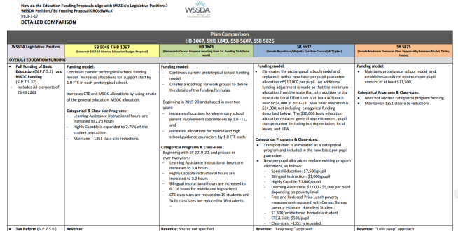
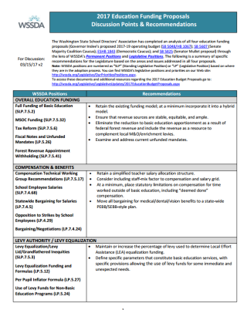
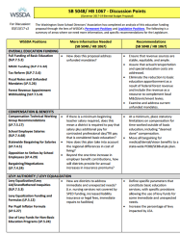
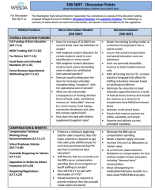
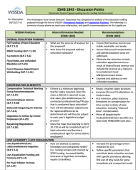
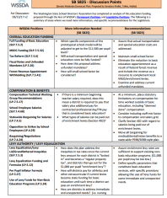
Deeper Dive – Ed. Funding
Ed Funding Proposals – WSSDA “Toolkit” WSSDA web page
Toolkit includes:
Side-by-side comparison of ALL FOUR proposals with WSSDA legislative positions
Recommendations & Discussion Points documents
Most current version will always be posted to the Web site
“Next Step” ideas for districts:
Review the general Recommendations and identify a couple that resonate with your school district to dig into and discuss with your local legislators.
Pick a specific plan (HB 1843 or SB 5607) and review the questions and discussion points. Then, identify a couple of key questions/issues for your district to dig into by reviewing data and discuss/share with your local legislators.
Other updates from this week:
Levy Cliff bill interpretation update, etc.
WSSDA meetings this week (D caucus leadership (H and S); R caucus outreach (H and S);) – general take-away’s & next steps
Legislator-only meetings of “4 corners” meetings scheduled 2x/week (Mondays/Wednesdays)
Key Legislators: Senators Rossi, Rivers, Rolfes, Billig; Representatives Harris, Taylor, Lytton, Sullivan

Slide 17
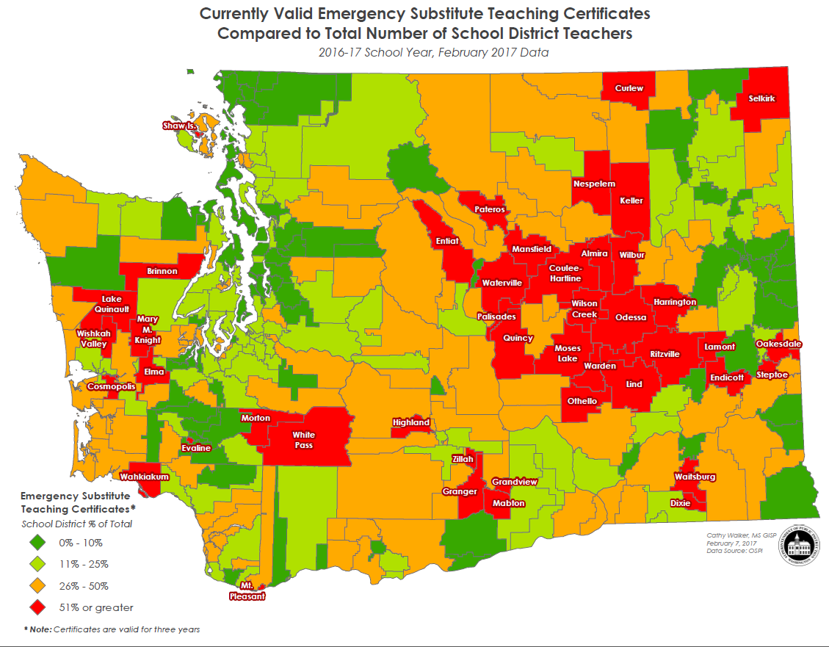
Deeper Dive – Teacher Shortage (Recruitment & Retention Issues)
The problem:
Resources:
OSPI teacher shortage Web page
Dec. 2016 Principal Survey results
Regional data
Statewide recruitment campaign
Sharing & Discussion points:
What’s the status of your district?
Out-of-state recruitment?
Grow your own approaches?
Challenges with professional certification?

Slide 18
Deeper Dive – Teacher Shortage (Recruitment & Retention Issues)
The bills:
Educator certification and evaluation :
2SHB 1341 (H) provides three options for teacher professional certification (ProTeach portfolio, National Board Certification, and 75 clock hour professional development credits). The bill also creates a collaborative advisory group that will be instrumental in working with the Professional Educator Standards Board to review and refine requirements for professional (“Tier 2”) certification in the longer term;
HB1319 (H) allows teachers who earn a three or four on their focused evaluation to continue with focused evaluations for six years before receiving a comprehensive summative evaluation (currently required every four years); and
EHB 1654 (explicit alternative routes for teacher certification programs).
HB 1827 relates to expanding the current and future educator supply. There is some discussion that this bill, or provisions contained within it, could be considered Necessary to Implement the Budget (NTIB) so keep an eye open as budget negotiations continue.
Educator recruitment and increasing the diversity of the educator workforce:
HB 1445 (H) regarding dual language in K-12 ed; and
SB 5712 that includes specific strategies to increase bilingual and/or dual language instruction educator supply and include “grow-your-own” strategies meant to get middle and high school students interested in teaching as a career.

Slide 19
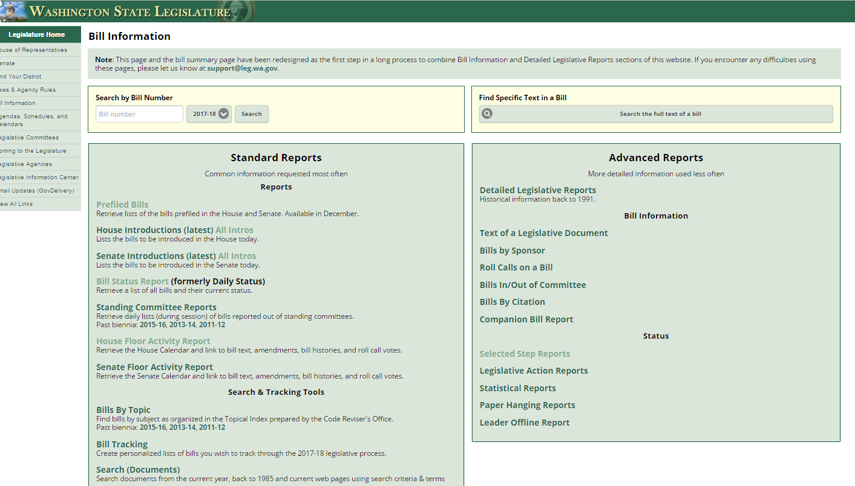
What is the status of XX bill?
Bill Information and Tracking - From these pages you can follow the bills you are most interested in and also provide comments on bills.
Bill Information page provides more in-depth options for learning more about what’s happening
Roll Call votes and other Bill details
Floor Activity Status
House
Senate

Slide 20
Understanding “dead” bills & how to revive
During Regular Session:
Necessary To Implement the Budget
Fiscal Impacts – with accompanying bills
Budget Proviso
Budget Provisos (some with/without $)
During Special Session:
If still in original House – bills stay where they last ended
If on the Floor Calendar – bills revert back to Rules
If in opposite House – bills revert back to the House of Origin (Rules)
Leadership generally agree on what “types” of bills continue on for deliberation through the Special Session.

Slide 21
WA State Legislature Resources
WA State Legislature
Bill Information and Tracking - From these pages you can follow the bills you are most interested in and also provide comments on bills.
Legislative Committee Information - Find out who is on what committee and what their meeting agendas include.
Schedules: To find more details on the Committee Meeting agendas, visit the House Committee or Senate Committee Web sites and click on the Committee you are interested in.
TVW - TVW is a great resource where you can watch hearings live, or go to the Archives to view past hearings of interest, just select the date and committee.

Slide 22
Things to remember
Looking Ahead

Slide 23
Next Week’s Webinar
Updates and Actions:
Week 11 recap
Bill and issue updates
Week 12 preview – work sessions, public hearings
Foundations:
TBD
Preparing for WSSDA proposal review and submission process (Legislative Assembly)
Thoughts?

Slide 24
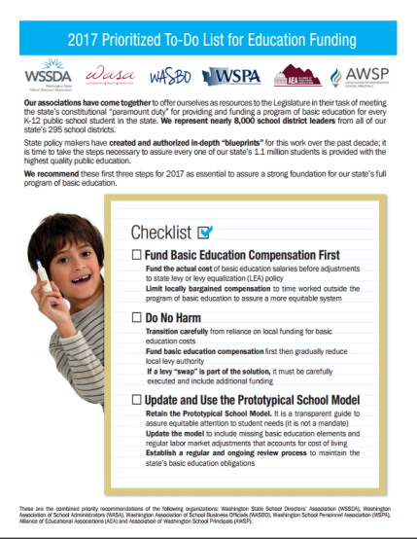
2017 WSSDA Legislative Priorities http://wssda.org/Legislative/OurPrioritiesPositions.aspx
2016 Legislative Assembly (September)
95 school district board delegates
Deliberated 62 legislative positions
2017 Priorities (Top 20 rankings from Leg. Assembly)
Invest in our students
Funding, levies, revenue
Support our schools
Facilities, school construction & siting
Public records requests
Attract and retain quality staff
Compensation
Bargaining
Teacher recruitment, retention, professional development
Joint Association Ed Funding Priorities
Prioritized To-Do List for Education Funding

Slide 25
WSSDA Resources for learning and communications
New: 2017 Education Budget Proposal web page – includes general information about proposals along with side-by-side comparisons
WSSDA’s Legislative Representative Web Page – this is a new web page just for school district board legislative reps. It is where you can register for the weekly updates and also access quick links for legislative activities.
WSSDA Legislative Updates - Includes weekly committee schedules, bill watch lists, and WSSDA’s legislative updates during the legislative session
WSSDA Advocacy Resources - Organized by WSSDA position categories

Slide 26
WSSDA Resources, cont’d
WSSDA opportunities:
Know and Access your Legislative Committee DA Representatives (elected at Annual Conference)
Participate in key statewide events:
WSSDA Legislative Assembly – set WSSDA’s legislative priorities (Sept)
Legislative Conference and Day on the Hill in Olympia (with WASA / WASBO) (Jan/Feb)
Serve as your board’s Legislative Representative, discuss issues with your board
Attend WSSDA Regional meetings in the Spring or Fall
Tune-in:
Sign-up for WSSDA eClips
During session: weekly Legislative Updates to members;
Social media (Facebook & Twitter):You don’t have to have an account to follow “tweeters” during the session!
Follow Jessica or #wssdaleg and also check out #WAedu and #WAleg

Slide 27
In closing….Why are YOUR legislative partnerships & priorities important?
1.1 million
K-12 Students
295
School districts
147
Legislators
1,477
YOU
YOU’VE been entrusted in your community
Power in numbers and voice
How can we better engage / involve Leg. Reps across the state??
Decisions made in Olympia DO and WILL affect your district

Slide 28
Questions / Comments?
Use the Chat/Question Box
Or
Contact: Jessica Vavrus, Gov’t Relations Director, j.vavrus@wssda.org ; 360-890-5867

Slide 29
Thank you!
Talk to you next week!

