Slide 1
WSSDA’s Weekly Webinar: Legislative Assembly Preparations Week 12 Update
March 31, 2017
Notes:
Welcome slide

Slide 2
Welcome! Please type your name, school district / organization, and role into the chat box!
Webinar Materials (3 documents):
PowerPoint presentation (ppt)
Legislative Schedules:
Week 12 review (pdf)
Week 13 preview (pdf)
Bill Watch List, updated 3/30/17
Logistics
Webinar materials (Leg Update Web Page)
http://wssda.org/Legislative/LegislativeUpdates.aspx
Q&A / Comment process
Chat and Question Boxes
Phones on mute
Leg. Assembly Preparations – recording and resources (WSSDA Leg. Assembly Page)
Leg. Update Webinar recordings & ppt materials (Leg Rep Web Page)
http://wssda.org/Legislative/SchoolBoardLegislativeRepresentatives.aspx
Introductions
WSSDA Staff
Jessica Vavrus, Gov’t Relations Director, j.vavrus@wssda.org and/or 360-890-5867
Tricia Kimbrough, Legislative Coordinator, t.kimbrough@wssda.org
Notes:
Jessica

Slide 3
Today’s Focus
Legislative Assembly Participation: Informational Overview
Week 12 Legislative Update
WSSDA’s year-long cycle for legislative advocacy
The role of WSSDA’s Legislative Assembly to define 2017 priorities
The Foundations: WSSDA’s legislative positions and priorities
How to get involved, who should attend, & ways to engage your colleagues
How to submit a proposal
Key dates and next steps
Updates & Actions
Key Dates
Process check
Weekly Recap & Week Ahead Preview
Deeper Dive & Foundations:
Issue areas for continued engagement
Budget Updates
Operating
Capital

Slide 4
Wssda’s legislative assembly
Legislative Positions & Proposal Submission Process
Important Dates
Process Support

Slide 5
WSSDA’s Annual Position Review & Prioritization Process
STEP 3
September:
Legislative Assembly - Priorities Ranked
STEP 4
Oct/Nov: Priorities Finalized and Approved
STEP 5
Jan. - April: Legislative Session
STEP 1
April - May:
Proposals Submitted
STEP 2
June - July: Proposals Refined and Finalized
WSSDA’s Legislative Assembly is a key event that shapes WSSDA’s annual Legislative Priorities.
WSSDA’s Legislative Committee solicits input from all Washington school boards on issues affecting public education.
The Legislative Assembly then acts on these proposals and creates a comprehensive legislative agenda for the coming Legislative Session.

Slide 6
2017 Legislative Assembly: What to expect
September 22 & 23, 2017, SeaTac, Southcenter DoubleTree Hotel
Pre-Assembly Day (Friday)
Assembly Day (Saturday)
WSSDA task-force meetings (AM)
“New to Assembly” luncheon
Pre-Assembly Program – presentations on key issues/hot topics related to WSSDA’s legislative positions
Director Area Caucus meetings (tentative)
Who attends?
Directors, superintendents, education stakeholder partners
“New to Assembly” refresher
Deliberation, voting, prioritizing of positions
Who attends?
Directors, superintendents
Only district “delegates” are eligible to vote

Slide 7
Who Should Attend?
All school directors are encouraged to attend the Legislative Assembly.
Each board should at least identify ONE representative to attend who can advocate for the board’s priorities
District staff are also invited to attend, although only school directors may address the assembly and only one director per district may vote on each issue.
While legislative representatives from each district normally serve as delegates to the assembly, voting credentials may be shared among attending directors at each board’s discretion.
Notes:
Tony

Slide 8
School District participation is essential
 | LA 2010 | LA 2011 | LA 2012 | LA 2013 | LA 2014 | LA 2015 | LA 2016
Number of Districts Represented | 85 | 84 | 102 | 95 | 91 | 92 | 99
Percentage of Districts | 29% | 28% | 35% | 32% | 31% | 31% | 34%
Each school board designates a “delegate” with voting credentials (usually the Legislative Representative)
Often, boards have more than one person attend Assembly with the delegate to allow for discussions on issues
The districts that attend, vote, and prioritize positions at the Assembly set the course for WSSDA’s legislative platform in the coming session!

Slide 9
Get Involved: Learn about the process and WSSDA’s current legislative positions
Participate in / view WSSDA’s informational webinar (March 31)
Review WSSDA’s 2017 Legislative Positions and Priority Ranking
http://wssda.org/Legislative/OurPrioritiesPositions.aspx
http://wssda.org/Events/LegislativeAssembly.aspx
Establish the top priorities your Board cares about
Review WSSDA positions in light of your Board’s priorities
Which positions should continue?
Are there positions missing on important issues?
Notes:
Jessica

Slide 10
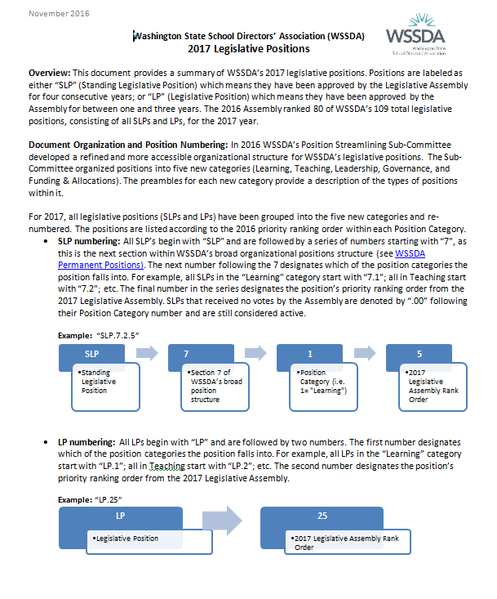
Navigating WSSDA Positions http://wssda.org/Legislative/OurPrioritiesPositions.aspx
109 total legislative positions
Standing Legislative Positions (SLPs)
Approved by the Legislative Assembly for four consecutive years
Reviewed annually by WSSDA Streamlining Sub-Committee (Leg. Committee + Board of Directors)
Legislative Positions (LPs)
Approved by the Assembly for between one and three years
Submitted annually by school boards and/or WSSDA Legislative Committee
2017 positions re-organized
5 broad categories (Learning, Teaching, Leadership, Governance, Funding & Allocations)
New numbering system

Slide 11
Navigating WSSDA Positions, Cont.
2017 Legislative Positions: Full compilation of WSSDA’s 2017 Legislative Positions organized by category.
2017 Position Quick Reference Spreadsheet (Excel)
2017 Position Resource 1-Pagers: These documents group like-positions (including any pertinent WSSDA Permanent Positions) to more easily navigating WSSDA’s 2017 legislative positions.
K-12 Learning Standards and Assessments
Teacher Recruitment, Retention, Certification, and Professional Development
Governance Positions: Local Control, State/Local Government Provisions, Employee Provisions
Funding, Compensation, Levy Reform
K-12 Facilities and Capital Construction
2017 Legislative Position Priority Listing: Priority ranking results from the 2016 Legislative Assembly.

Slide 12
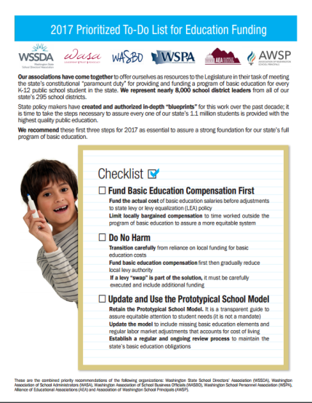
2017 WSSDA Legislative Priorities http://wssda.org/Legislative/OurPrioritiesPositions.aspx
2016 Legislative Assembly (September)
95 school district board delegates
Deliberated 62 legislative positions
2017 Priorities (Top 20 rankings from Leg. Assembly)
Invest in our students
Funding, levies, revenue
Support our schools
Facilities, school construction & siting
Public records requests
Attract and retain quality staff
Compensation
Bargaining
Teacher recruitment, retention, professional development
Joint Association Ed Funding Priorities
Prioritized To-Do List for Education Funding

Slide 13
Get Involved: Submit a position proposal
Consider submitting a new or returning position proposal
Collaborate with other districts - Sometimes more than one district has a similar issue they wish to address with a legislative proposal so it is not uncommon for districts to come together in submitting a collaborative proposal.
New in 2017:
Two position proposal submission forms: New and Returning
Longer submission window (March 31 – June 2)
Notes:
Jessica

Slide 14
Get Involved: Submitting a position proposal
Things to consider
Issue or focus area of the proposed (or continuing) position
Proposed position statement wording – this will be refined over the summer with staff and the Legislative Committee
Proposed “Argument For…” – this will be refined over the summer with staff and the Legislative Committee
Should include: how issue pertains to school districts/directors statewide (i.e., impacts to student learning, student supports/safety, school district policies, funding, etc.); consequences if not addressed; how the issue may affect local control and/or school district accountability
Which existing WSSDA Legislative Priorities or SLPs does the issue pertain to? (if applicable)
Additional Information: WSSDA position history? Anticipated costs? Pertinent research/resources?
Notes:
Jessica

Slide 15
Get Involved: Submit a Proposal & Participate in the Process
Proposal Submission – Review and Refinement
WSSDA staff and the Legislative Committee will review all proposals and synthesize for the Assembly (June and July)
Proposers are contacted with questions and will have an opportunity to review the final wording of the proposal and argument
Legislative Committee issues a recommendation (Do Pass or Do Not Pass) for each proposal to be considered
All proposals are compiled into the Legislative Assembly Guide for all participants to reference at the Assembly
Attend the Assembly!
Review materials in advance so you’re ready
Participate in “New to Assembly” meetings & Director Area Caucus Meetings
Notes:
Jessica

Slide 16
Key Dates
March 31 – Proposal solicitation begins
June 2 – Deadline for proposal submissions
June 7 – Registration for 2016 Legislative Assembly and lodging at the Southcenter DoubleTree Hotel (SeaTac)
September 22 & 23 – 2017 Legislative Assembly, SeaTac
Notes:
Jessica

Slide 17
Next Steps
Submit a Proposal
Work with your board to submit a new or returning proposal
Complete the appropriate form online
Note: Forms are also available in Word solely for Board review/approval processes
Work with WSSDA’s Legislative Committee members and staff to refine position proposals over the summer
Register, Attend, Participate
Registration opens June 7th
Sept. 23-23 – 2017 Legislative Assembly, SeaTac
Notes:
Jessica

Slide 18
Questions? Thoughts? Clarifications?
Notes:
Jessica

Slide 19
Legislative updates: Week 12
Weekly recap Bill/Issue Updates the week ahead

Slide 20
Key Session Dates
Feb. 17 – House Policy Committee Cutoff
Feb. 24 – Fiscal Committee Cutoff
March 8 – House of Origin Cutoff
March 29 – Policy Cutoff – Opposite House
April 4 – Fiscal Cutoff – Opposite House
April 12 – Opposite House Cutoff
April 23 – Last Day of 105-day Regular Session
Note: these deadlines are important to help “weed out” bills; but they also can get in the way…

Slide 21
Law-Making Process – where are we now?
Chamber #1
Introduced
Hearing
Comm. Vote
Rules (2-3 votes)
Floor Calendar
Floor Vote
Chamber #2
Introduced
Hearing
Comm. Vote
Rules (2-3 votes)
Floor Calendar
Floor Vote
Reconciliation
Conference agreement
Floor vote
Floor vote
Governor
Partial/ Full Veto
Interpretive statement
Through 4/4 (fiscal bills) AND 4/12 (Opposite House bills):
Public Hearings
Committee Votes
Floor Votes
Conference agreements

Slide 22
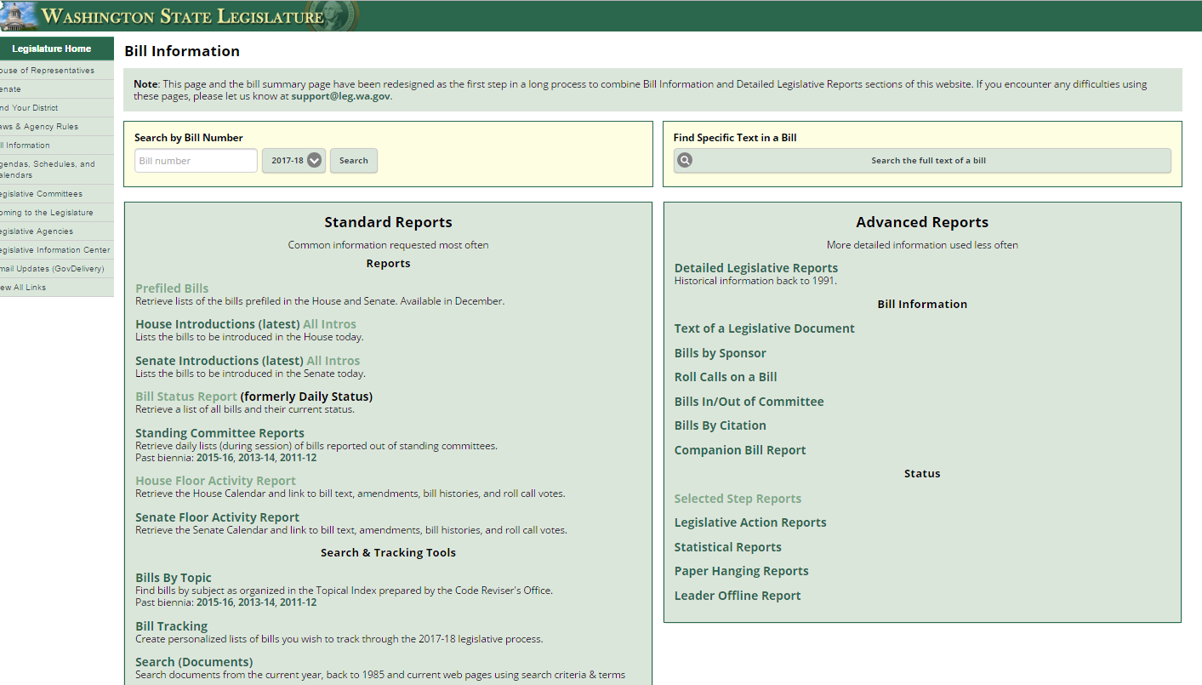
What is the status of XX bill?
Bill Information and Tracking - From these pages you can follow the bills you are most interested in and also provide comments on bills.
Bill Information page provides more in-depth options for learning more about what’s happening
Roll Call votes and other Bill details
Floor Activity Status
House
Senate

Slide 23
Understanding “dead” bills & how to revive
During Regular Session:
Necessary To Implement the Budget (“NTIB”)
Fiscal Impacts – with accompanying bills
Budget Proviso
Budget Provisos (some with/without $)
During Special Session:
If still in original House – bills stay where they last ended
If on the Floor Calendar – bills revert back to Rules
If in opposite House – bills revert back to the House of Origin (Rules)
Leadership generally agree on what “types” of bills continue on for deliberation through the Special Session.

Slide 24
Week Schedule, Participating & Providing Input
March 27 – April 1, 2017 – updated 3/31/17
April 3 - 7, 2017 – as of 3/30/17
Participating & Providing Input:
Legislator Contacts
Includes worksheets with committee member and staff listings
Rules Committees (as bills move out of committee)
House
Senate
Ways to stay connected:
Floor Activity Status House Senate
TVW Channels: House Senate
Twitter: #waleg

Slide 25
Week 12 Recap and Week 13 Preview: Highlighted Bill / Issue Actions
Key: H = Public Hearing held// H = Public Hearing scheduled// ES = Executive Session scheduled// PC/FC = Passed/Failed Committee // R = Rules // FL = Floor Calendar// PS/FS = Passed/Failed Senate// PH/FH = Passed/Failed House // PL = Passed Legislature (awaiting Gov action) // SL = Session Law
Learning (WSSDA Position Category 1)
Curriculum / Instruction:
SSB 5064 (students’ freedom of expression) ES
2SSB 5236 (civic learning public-private partnership) ES
ESSB 5449 (digital citizenship, media literacy, internet safety) PC/R
ESHB 1481 (driver education uniformity) PC/R
Assessments / Graduation Requirements:
SB 5891 (Delaying requirement of science high school assessment as graduation requirement until the Class of 2021) PS
SB 5639 (Alternative student assessments) **House Ed. Striking Amendment replaced text of this bill with that of HB 1046 (Delinking ELA, Math, Science high school assessments as graduation requirements) H
SHB 1235 (Physical Education Assessments and Reporting) PH / PS
Student Supports & Student Nutrition:
SHB 1508 (Student Nutrition/Breakfast after the Bell) ES, referred to W&M
EHB 1551 (equipment assistance grant program to enhance student nutrition in public schools) ES, referred to W&M
SHB 1618 (Family and community engagement coordinators) H
Dual Language / Bilingual Ed: SHB 1445 (Dual language in early learning & K12) ES
Truancy:
2SHB 1170 (Truancy reduction) ES, referred to W&M
ESSB 5293 (court-based and school-based efforts to promote attendance and reduce truancy) H in Approps.
Homeless / Foster Youth:
SSB 5241 (educational success / credit attainment) R
SHB 1816 (homeless youth information sharing) ) H
SHB 1867 (extended foster care transitions) ) PC
SHB 1641 (homeless youth health care) R

Slide 26
Week 12 Recap and Week 13 Preview: Highlighted Bill / Issue Actions
Key: H = Public Hearing held// H = Public Hearing scheduled// ES = Executive Session scheduled// PC/FC = Passed/Failed Committee // R = Rules // FL = Floor Calendar// PS/FS = Passed/Failed Senate// PH/FH = Passed/Failed House // PL = Passed Legislature (awaiting Gov action) // SL = Session Law
Teaching (WSSDA Position Category 2)
Certification
2SHB 1341 (professional certification for teachers/administrators) R
EHB 1654 (explicit alternative routes for teacher certification programs) R
Recruitment / Retention
HB 1445 (dual language in K-12 ed) ES
SB 5712 (bilingual ed workforce) ES
Education Support Associates / Student Supports:
SSB 5142 (Educational interpreters) R
SB 5325 R / SHB 1346 R (Nurse in a school setting)
ESHB 1115 ES / SB 5070 H (Paraeducators)
Keep an eye on:
HB 1827 Referenced H-Budget (broad bill to address many components related to Teacher Recruitment, Educator Retention, Evaluation of Educator Effectiveness, Educator Certification, Incentives and Assistance for Educators)
Considered Necessary to Implement the Budget (NTIB)

Slide 27
Week 12 Recap and Week 13 Preview: Highlighted Bill / Issue Actions
Key: H = Public Hearing held// H = Public Hearing scheduled// ES = Executive Session scheduled// PC/FC = Passed/Failed Committee // R = Rules // FL = Floor Calendar// PS/FS = Passed/Failed Senate// PH/FH = Passed/Failed House // PL = Passed Legislature (awaiting Gov action) // SL = Session Law
Leadership (WSSDA Position Category 3)
SHB 1279 (School Safety Drills) R
SSB 5404 (Sunscreen in Schools) R
2SSB 5107 (Early Childhood Ed/Assistance) ES – referred to Approps.
Governance (WSSDA Position Category 4)
EHB 1017 (School Siting) R
HB 1800 (Voting Rights Act) ES - dead
SB 5068 (Voting Rights Act – cities, towns, code cities, counties – DOES NOT CURRENTLY INCLUDE SCHOOL DISTRICTS) ES
HB 1595 (public records request costs) R
HB 1594 (improving public records administration) H
HB 1060 (Medical Marijuana in schools) ES
SHB 1886 (SBE / OSPI Governance Accountability Roles) ES
SSB 5641 (school district class naming) R
Keep an eye on:
SB 5726 (School Employee Health Care Benefits -Requires that school and educational service districts provide based health care to employees through the Public Employee Benefits Board)

Slide 28
Week 12 Recap and Week 13 Preview: Highlighted Bill / Issue Actions
Key: H = Public Hearing held// H = Public Hearing scheduled// ES = Executive Session scheduled// PC/FC = Passed/Failed Committee // R = Rules // FL = Floor Calendar// PS/FS = Passed/Failed Senate// PH/FH = Passed/Failed House // PL = Passed Legislature (awaiting Gov action) // SL = Session Law
Funding & Allocations (WSSDA Position Category 5)
Education Policy & Budget Bills:
Policy Bills
Overall: SSB 5607 PS + ESSB 5875 PS, ESHB 1843 PH, SB 5825 H
CTE: SB 5853 H (likely dead)
Learning Assistance Program modifications: SSB 1511 (components could inform budget discussions)
Budget Bills- SB 5048 PS, HB 1067 H
Levy Lid Delay - ESB 5023 (Levy Lid Delay) SL
IMPORTANT: Communicate your thanks to your legislators AND….share your timeline for taking board action on levies that will go on the ballot in 2018
SB 5664 (Federal Forest Revenue Deductions) H – NOTE: NOT included in either budget as proviso
Note: Secure and Rural Schools Federal funding was not reauthorized by Congress, thus increasing the importance of this bill (or proviso) given the large reduction of federal forest revenue coming to states as a result.
Operating Budget Revenue Bills:
Operating Budgets: SSB 5048 (Senate proposal); SHB 1067 (House proposal)
Revenue Bills: SB 5111 (Capital gains) FS; SB 5113 FL / HB 1550 (B&O modifications); SB 5127 FL (Carbon tax); HB 1549 / SB 5112 (eliminate tax preferences); HB 2186 (full House revenue compilation bill) H; HB 2164/ HB 2163 (Revenue T.O.)
Capital Facilities / Capital Budget
SB 5702 (improving state funding for school construction, modernization, and asset preservation) H
SB 5453 (school construction grants for small, rural schools) PC
SSB 5644 (skill center facility maintenance) R
2SHB 1777 (financing early learning facilities) ES
HB 1203 (Exempting school districts from the state portion of sales and use taxes on school construction)
Bond Bills: SB 5090 / HB 1080 (Concerning state general obligation bonds and related accounts)
Capital Budget Bills: SB 5086 PS / HB 1075 H, and HB 2170 (Capital Budget T.O.)
Miscellaneous - See current WSSDA Bill Watch List (to be updated 3/30/17)

Slide 29
Deeper dive & foundations
Ed Funding Proposals & information sharing
Where we are in the process

Slide 30
Past Deep Dive Topics
Budget Proposals
Senate operating budget proposal – 3/27/17
Teacher Shortage Issues (recruitment, retention, certification) – 3/17/17
School Siting (building schools outside of Urban Growth Areas) – 3/10/17
High School Assessment Graduation Requirements – 3/10/17
Education Funding Issues – 3/10/17
Understanding and Navigating Bills / Legislative Process – January & February webinars

Slide 31
2017-19 House Operating Budget Proposal
Budget Bill - SHB 1067
SHB 1067 “Summary” (pp. 2, and pp.7-14)) and the “Agency Detail” (p. 9 and pp.168-189)
Washington State’s Fiscal Information Web Portal (fiscal.wa.gov) is a great source for accessing budget comparison charts and overview documents
WASA’s This Week In Olympia Special Edition (3/28/17) House Budget Overview
Policy Bill Changes to SHB 1843– new bill: HB 2185
Section 102(8) clarifies that the specific minimum salary allocations specified in the bill for each of the three staff types include the allocations for professional learning days.
In section 104(4) a reference to Article IX, section 3 of the constitution is corrected to refer to section 1 of Article IX, rather than section 3.
A new section is added (Sec. 107), revising the apportionment schedule to apportion professional learning days in July of each school year.
Part II (LEA and Local Levies) is redrafted to the current law reflecting the changes to the law that were enacted under ESB 5023 (levy cliff delay).
Section 301(2) and Section 302(2) - A technical correction is made to specify that the funding is for allocation purposes only, except as provided in subsection 4, which provides that districts receive K-3 class size funding in proportion to their actual class sizes.
Section 301(4) is revised. The limitation on the K-3 class size funding allocations is revised to begin with the 2019-20 school year, rather than the 2017-18 school year.
New sections are added (Sec. 303 and Sec. 307), and effective dates for sections 301 and 302 are revised, to delay the implementation schedule for I-1351. The initiative is delayed 2 years.
Implementation of reduced CTE and Skills Center class size is delayed by two years, changing from completion in the 2020-21 school year to completing in the 2022-23 school year.
Language requiring specific accounting and reporting changes related to Local M&O levies and language requiring a new process for submitting M&O levies to the voters is removed.

Slide 32
Operating & Education Budget Next Steps
Operating Budget Discussions:
Senate Budget (SHB 5048) debated in House 3/30 & 3/31
House Budget (SHB 1067) to be discussed/voted on by House on 3/31 (?)
Education Budget Considerations:
“Sticky” Issues:
Funding model
Salary allocation approach (staff mix; categorical funding; student-centered funding)
Poverty measures (FRL vs. Census)
Revenue
Weekly discussions among H and S education leads
Key Legislators: Senators Rossi, Rivers, Rolfes, Billig, Braun, Fain; Representatives Harris, Taylor, Lytton, Sullivan
Weekly stakeholder meetings that include WSSDA’s Legislative Committee Chair, Geoffery McAnalloy (Federal Way Board President)
Weekly WSSDA Legislative Committee meetings
Share your thoughts with WSSDA staff and your Legislative Committee D.A. Representatives
NOW WHAT??
Policy makers are in the midst of the fundamental discussions and negotiations
Districts should:
Use the district impact spreadsheets to identify impacts for your district – communicate good things and concerns (keep WSSDA in the loop!)
Review current Education Funding Recommendations & Discussion Points
Add your district’s input to the WASA/WSSDA Ed Funding Survey data
Email Jessica at j.vavrus@wssda.org for the link!
Resource: WSSDA’s 2017 Education Funding Proposal Web page

Slide 33
2017-19 Capital Budget Proposals
SSB 5086 - Senate proposed capital budget
Passed by full Senate unanimously
$1.1 billion for K-12 (represents 35% of state capital budget (up from 26%))
Funds increase in SCAP funding; rural school grants; skill center and CTE projects; emergency repairs, equal access modifications;
Limited increases in K-3 class-size reduction construction grants
Resources:
Capital budget bill documents
SSB 5086 “Summary” (pp.7 and 15)
Capital budget comparison charts
The House Capital Budget Committee is anticipated to release their proposed 2017-19 capital budget early next week (Thursday).

Slide 34
Upcoming events Next Week’s Webinar
Looking Ahead

Slide 35
Upcoming Events
WSSDA Spring Regional Meetings
Started this week!

Slide 36
Next Week’s Webinar
Updates and Actions:
Weekly recap / Week ahead
Bill and issue updates
Deeper Dives:
Education Funding Plan / Budget Updates
Capital Budgets

Slide 37
resources

Slide 38
WA State Legislature Resources
WA State Legislature
Bill Information and Tracking - From these pages you can follow the bills you are most interested in and also provide comments on bills.
Legislative Committee Information - Find out who is on what committee and what their meeting agendas include.
Schedules: To find more details on the Committee Meeting agendas, visit the House Committee or Senate Committee Web sites and click on the Committee you are interested in.
TVW - TVW is a great resource where you can watch hearings live, or go to the Archives to view past hearings of interest, just select the date and committee.

Slide 39
WSSDA Resources for learning and communications
New: 2017 Education Budget Proposal web page – includes general information about proposals along with side-by-side comparisons
WSSDA’s Legislative Representative Web Page – this is a new web page just for school district board legislative reps. It is where you can register for the weekly updates and also access quick links for legislative activities.
WSSDA Legislative Updates - Includes weekly committee schedules, bill watch lists, and WSSDA’s legislative updates during the legislative session
WSSDA Advocacy Resources - Organized by WSSDA position categories

Slide 40
WSSDA Resources, cont’d
WSSDA opportunities:
Know and Access your Legislative Committee DA Representatives (elected at Annual Conference)
Participate in key statewide events:
WSSDA Legislative Assembly – set WSSDA’s legislative priorities (Sept)
Legislative Conference and Day on the Hill in Olympia (with WASA / WASBO) (Jan/Feb)
Serve as your board’s Legislative Representative, discuss issues with your board
Attend WSSDA Regional meetings in the Spring or Fall
Tune-in:
Sign-up for WSSDA eClips
During session: weekly Legislative Updates to members;
Social media (Facebook & Twitter):You don’t have to have an account to follow “tweeters” during the session!
Follow Jessica or #wssdaleg and also check out #WAedu and #WAleg

Slide 41
In closing….Why are YOUR legislative partnerships & priorities important?
1.1 million
K-12 Students
295
School districts
147
Legislators
1,477
YOU
YOU’VE been entrusted in your community
Power in numbers and voice
How can we better engage / involve Leg. Reps across the state??
Decisions made in Olympia DO and WILL affect your district

Slide 42
Questions / Comments?
Use the Chat/Question Box
Or
Contact: Jessica Vavrus, Gov’t Relations Director, j.vavrus@wssda.org ; 360-890-5867

Slide 43
Thank you!
Talk to you next week!

