Slide 1
WSSDA’s Weekly Legislative Update
WEEK 8: March 3, 2017
Notes:
Welcome slide

Slide 2
Welcome! Please type your name, school district / organization, and role into the chat box!
Webinar Materials (3 documents):
Legislative Schedules:
Week 9 preview (pdf)
Bill Watch List, 3/3/17
PowerPoint presentation (ppt)
Logistics
Webinar materials (Leg Update Web Page)
http://wssda.org/Legislative/LegislativeUpdates.aspx
Q&A / Comment process
Chat and Question Boxes
Phones on mute
Webinar recordings & ppt materials (Leg Rep Web Page)
http://wssda.org/Legislative/SchoolBoardLegislativeRepresentatives.aspx
Introductions
WSSDA Staff
Tim Garchow, WSSDA Executive Director, t.garchow@wssda.org
Jessica Vavrus, Gov’t Relations Director, j.vavrus@wssda.org and/or 360-890-5867
Tricia Kimbrough, Legislative Coordinator, t.kimbrough@wssda.org
Notes:
Jessica

Slide 3
Today’s Focus
Updates & Actions
Key Dates
Bill Watch – Bill/Issue highlights
Weekly Recap & Week Ahead Preview
Deeper Dive & Foundations:
Ed Funding Proposals & information sharing
Where we are in the process

Slide 4
WSSDA’s Weekly Legislative Update Webinars: Purpose and Audience
Who:
School Board Legislative Representatives
Other interested school directors
What:
Timely legislative and bill / issue updates
Summary of the week’s activities and preview to hearings for the coming week
Orientation to the legislative process, bill tracking, and web-based resources
Why:
To engage and empower school board legislative representatives to work with their boards and communities in legislative issues that matter the most
Where/When:
Every Friday during the Legislative Session, at 12:00
Register here: http://wssda.org/Legislative/SchoolBoardLegislativeRepresentatives.aspx
Recording will be posted to the web site

Slide 5
Weekly recap Bill/Issue Updates the week ahead

Slide 6
Key Session Dates
Feb. 17 – House Policy Committee Cutoff
Feb. 24 – Fiscal Committee Cutoff
March 8 – House of Origin Cutoff
March 29 – Policy Cutoff – Opposite House
April 4 – Fiscal Cutoff – Opposite House
April 12 – Opposite House Cutoff
April 23 – Last Day of 105-day Regular Session
Note: these deadlines are important to help “weed out” bills; but they also can get in the way…

Slide 7
Week 8 Recap: By the Numbers (as of March 3, 8am)
~2,000 bills, joint resolutions, memorials introduced
286 on WSSDA’s Bill Watch List
 | Learning | Teaching | Leadership | Governance | Funding & Allocations | Misc.
Total Bills (293) | 90 | 35 | 12 | 72 | 61 | 23
Passed to Opposite House (37) | 17 | 3 | 3 | 2 | 8 | 1
On Floor or in Rules (55) | 17 | 14 | 0 | 16 | 9 in Rules/Floor Most NTIB | 5

Slide 8
Week 8 Recap: Highlighted Bill / Issue Actions
Learning (WSSDA Position Category 1)
Passed Chamber
EHB 1551 (equipment assistance grant program to enhance student nutrition in public schools)
SHB 1235 (Physical Education Assessments and Reporting)
ESSB 5293 (court-based and school-based efforts to promote attendance and reduce truancy)
On Floor
SHB 1445 / SSB 5529 (Dual language in early learning & K12)
SHB 1508 (Student Nutrition/Breakfast after the Bell)
Still in Rules
HB 1046 (Delinking ELA, Math, Science high school assessments as graduation requirements)
SB 5708 (equipment assistance grant program to enhance student nutrition in public schools)
SSB 5155 (suspension and expulsion of kindergarten and early elementary school students)
2SHB 1170 (Truancy reduction)
Teaching (WSSDA Position Category 2)
Passed Chamber
2SHB 1341 (professional certification for teachers/administrators)
On Floor
SB 5529/ HB 1445 (dual language in K-12 ed)
SB 5712 (bilingual ed workforce)
Still in Rules
HB 1827 (broad bill to address many components related to Teacher Recruitment, Educator Retention, Evaluation of Educator Effectiveness, Educator Certification, Incentives and Assistance for Educators)

Slide 9
Week 8 Recap: Highlighted Bill / Issue Actions
Leadership (WSSDA Position Category 3)
Passed Chamber
SHB 1279 (School Safety Drills)
SSB 5404 (Sunscreen in Schools)
2SSB 5107 (Early Childhood Ed/Assistance)
Governance (WSSDA Position Category 4)
Passed Chamber
HB 1800 (Voting Rights Act)
On Floor
HB 1017 (School Siting – limited sites in E and W Washington)
Public Records Act Updates: HB 1595 (public records request costs) & HB 1594 (improving public records administration)
HB 1060 (Medical Marijuana in schools)
HB 1886 (SBE / OSPI Governance Accountability Roles)
Still in Rules
SB 5651 (School Siting - statewide)
SB 5726 (School Employee Health Care Benefits -Requires that school and educational service districts provide based health care to employees through the Public Employee Benefits Board)

Slide 10
Week 8 Recap: Highlighted Bill / Issue Actions
Funding & Allocations (WSSDA Position Category 5)
Passed Chamber & Assigned to Committees in Opposite House
Ed. Budget Bills (SSB 5607, ESHB 1843)
Levy Lid Delay (SHB 1059)
Federal Forest Revenue Deductions: SB 5664
SB 5702 (improving state funding for school construction, modernization, and asset preservation)
SB 5453 (school construction grants for small, rural schools)
On Floor
Gov. Inslee’s Revenue Bills (SB 5111, 5113, 5127)
In Rules
HB 1923 (school construction grants for small, rural schools)
Note: Most bills in this category are likely considered Necessary to Implement the Budget (NTIB) and therefore aren’t subject to committee cutoff dates.
Miscellaneous

Slide 11
Week Schedule + Participating & Providing Input
March 6-10, 2017 Schedule – as of 3/2/17
Mostly Floor action
Goal is for key bills to move out of Rules and off of the Floor by 5pm Wednesday, March 8
Public Hearings – bills to be added daily for hearings starting b back up 3/9/17
Participating & Providing Input:
Legislator Contacts
Education Committees (encourage Chairs to schedule bills (or not…))
House
Senate
Rules Committees (encourage members to pull bills to Floor)
House
Senate
Ways to engage:
Email and call your legislators regarding bills that are still alive
Discuss broad ideas to consider within bills and/or offer specific language for adjustments
Visit Olympia – WSSDA staff can help set up meetings! (if we know in advance…)

Slide 12
Deeper dive & foundations
Ed Funding Proposals & information sharing
Where we are in the process

Slide 13
Deeper Dive
Levy Lid Delay
HB 1059 in Senate Ways & Means
SB 5607 (Senate R/MCC budget) includes levy lid delay
Important: Continue sharing information with Legislators (Tim Garchow’s email to all WSSDA members Tuesday 2/21)
What is the fiscal impact of the levy cliff on your local school district?
If you must reduce expenditures, where will the cuts come from (i.e., program adjustments, staffing levels, etc.)?
What is the absolute latest date for you to make the necessary decisions on these reductions?
What challenges does the uncertainty of a levy cliff solution place on your district?

Slide 14
Deeper Dive
Ed Funding Proposals (WSSDA web page)
Updated:
Side-by-side comparison of ALL FOUR proposals with WSSDA legislative positions
Note: All proposals on the table are Necessary to Implement the Budget (NTIB) and therefore aren’t subject to committee cutoff dates
Coming next week:
WSSDA Discussion Document for SHB 1843 and SSB 5607
WSSDA / WASA information collection from Legislative Committees (survey)
Other:
Education Funding Task Force discussions underway
Regular meetings with caucus leaders
To consider and share input on:
WSSDA Legislative Position | Questions for Discussion | Recommendations
Funding model approach Compensation bargaining Salary/compensation allocation approach | Levy Lid Threshold Local Effort Assistance Healthcare Bargaining

Slide 15
Law-Making Process – where are we now?
Chamber #1
Introduced
Hearing
Comm. Vote
Rules (2-3 votes)
Floor Calendar
Floor Vote
Chamber #2
Introduced
Hearing
Comm. Vote
Rules (2-3 votes)
Floor Calendar
Floor Vote
Reconciliation
Conference agreement
Floor vote
Floor vote
Governor
Partial/ Full Veto
Interpretive statement
This & Next Week:
Rules Committees in both Chambers
Floor Votes

Slide 16
Good time to impact a “live” bill (before the RED)
Chamber #1
Introduced
Hearing
Comm. Vote
Rules (2-3 votes)
Floor Calendar
Floor Vote
Chamber #2
Introduced
Hearing
Comm. Vote
Rules (2-3 votes)
Floor Calendar
Floor Vote
Reconciliation
Conference agreement
Floor vote
Floor vote
Governor
Partial/ Full Veto
Interpretive statement

Slide 17
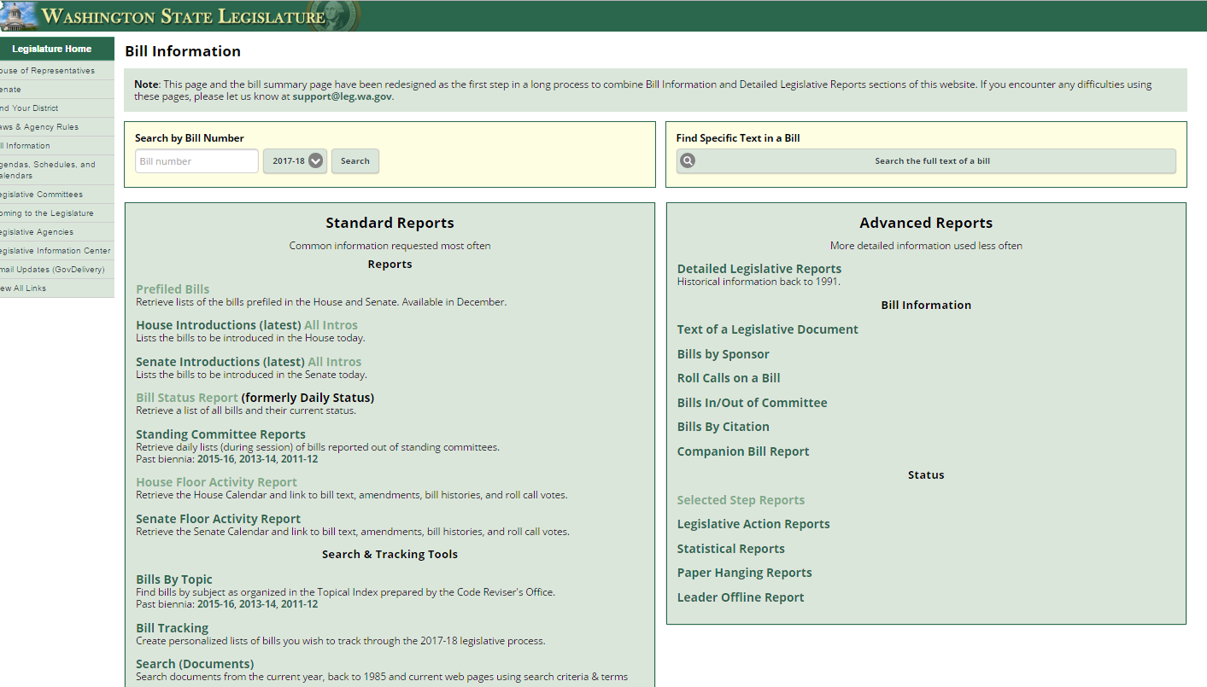
What is the status of XX bill?
Bill Information and Tracking - From these pages you can follow the bills you are most interested in and also provide comments on bills.
Bill Information page provides more in-depth options for learning more about what’s happening
Roll Call votes and other Bill details
Floor Activity Status
House
Senate

Slide 18
Understanding “dead” bills & how to revive
During Regular Session:
Necessary To Implement the Budget
Fiscal Impacts – with accompanying bills
Budget Proviso
Budget Provisos (some with/without $)
During Special Session:
If still in original House – bills stay where they last ended
If on the Floor Calendar – bills revert back to Rules
If in opposite House – bills revert back to the House of Origin (Rules)
Leadership generally agree on what “types” of bills continue on for deliberation through the Special Session.

Slide 19
WA State Legislature Resources
WA State Legislature
Bill Information and Tracking - From these pages you can follow the bills you are most interested in and also provide comments on bills.
Legislative Committee Information - Find out who is on what committee and what their meeting agendas include.
Schedules: To find more details on the Committee Meeting agendas, visit the House Committee or Senate Committee Web sites and click on the Committee you are interested in.
TVW - TVW is a great resource where you can watch hearings live, or go to the Archives to view past hearings of interest, just select the date and committee.

Slide 20
Things to remember
Looking Ahead

Slide 21
Next Week’s Webinar
Updates and Actions:
Week 9 recap
Bill and issue updates
Week 10 preview – work sessions, public hearings
Foundations:
TBD
Thoughts?

Slide 22
2017 WSSDA Legislative Priorities http://wssda.org/Legislative/OurPrioritiesPositions.aspx
2016 Legislative Assembly (September)
95 school district board delegates
Deliberated 62 legislative positions
2017 Priorities (Top 20 rankings from Leg. Assembly)
Invest in our students
Funding, levies, revenue
Support our schools
Facilities, school construction & siting
Public records requests
Attract and retain quality staff
Compensation
Bargaining
Teacher recruitment, retention, professional development
Joint Association Ed Funding Priorities
Prioritized To-Do List for Education Funding

Slide 23
WSSDA Resources for learning and communications
New: 2017 Education Budget Proposal web page – includes general information about proposals along with side-by-side comparisons
WSSDA’s Legislative Representative Web Page – this is a new web page just for school district board legislative reps. It is where you can register for the weekly updates and also access quick links for legislative activities.
WSSDA Legislative Updates - Includes weekly committee schedules, bill watch lists, and WSSDA’s legislative updates during the legislative session
WSSDA Advocacy Resources - Organized by WSSDA position categories

Slide 24
WSSDA Resources, cont’d
WSSDA opportunities:
Know and Access your Legislative Committee DA Representatives (elected at Annual Conference)
Participate in key statewide events:
WSSDA Legislative Assembly – set WSSDA’s legislative priorities (Sept)
Legislative Conference and Day on the Hill in Olympia (with WASA / WASBO) (Jan/Feb)
Serve as your board’s Legislative Representative, discuss issues with your board
Attend WSSDA Regional meetings in the Spring or Fall
Tune-in:
Sign-up for WSSDA eClips
During session: weekly Legislative Updates to members;
Social media (Facebook & Twitter):You don’t have to have an account to follow “tweeters” during the session!
Follow Jessica or #wssdaleg and also check out #WAedu and #WAleg

Slide 25
In closing….Why are YOUR legislative partnerships & priorities important?
1.1 million
K-12 Students
295
School districts
147
Legislators
1,477
YOU
YOU’VE been entrusted in your community
Power in numbers and voice
How can we better engage / involve Leg. Reps across the state??
Decisions made in Olympia DO and WILL affect your district

Slide 26
Questions / Comments?
Use the Chat/Question Box
Or
Contact: Jessica Vavrus, Gov’t Relations Director, j.vavrus@wssda.org ; 360-890-5867

Slide 27
Thank you!
Talk to you next week!

