Slide 1
WSSDA’s Weekly Legislative Update
WEEK 6: February 17, 2017
Notes:
Welcome slide

Slide 2
Welcome! Please type your name, school district / organization, and role into the chat box!
Webinar Materials (3 documents):
Committee Meeting Schedules:
Week 6 recap (pdf)
Week 7 preview (pdf)
Bill Watch List, 2/17/17 (coming this afternoon) (pdf)
PowerPoint presentation (ppt)
Logistics
Webinar materials (Leg Update Web Page)
http://wssda.org/Legislative/LegislativeUpdates.aspx
Q&A / Comment process
Chat and Question Boxes
Phones on mute
Webinar recordings & ppt materials (Leg Rep Web Page)
http://wssda.org/Legislative/SchoolBoardLegislativeRepresentatives.aspx
Introductions
WSSDA Staff
Tim Garchow, WSSDA Executive Director, t.garchow@wssda.org
Jessica Vavrus, Gov’t Relations Director, j.vavrus@wssda.org and/or 360-890-5867
Tricia Kimbrough, Legislative Coordinator, t.kimbrough@wssda.org
Notes:
Jessica

Slide 3
Today’s Focus
Updates & Actions
Week 6 Recap including bill / issue updates
Week 7 Preview
Bill Watch – bills of interest
Key Dates
Foundations:
Bill / amendments & tracking
Committees and communications

Slide 4
WSSDA’s Weekly Legislative Update Webinars: Purpose and Audience
Who:
School Board Legislative Representatives
Other interested school directors
What:
Timely legislative and bill / issue updates
Summary of the week’s activities and preview to hearings for the coming week
Orientation to the legislative process, bill tracking, and web-based resources
Why:
To engage and empower school board legislative representatives to work with their boards and communities in legislative issues that matter the most
Where/When:
Every Friday during the Legislative Session, at 12:00
Register here: http://wssda.org/Legislative/SchoolBoardLegislativeRepresentatives.aspx
Recording will be posted to the web site

Slide 5
Weekly recap Bill/Issue Updates the week ahead

Slide 6
Week 6 Recap
Monday’s Day on the Hill (2/13/17)
Bill / Issue Actions & Highlights
School Siting Bills (SB 5651 & HB 1017) Both bills assigned to Rules to await assignment to the Floor
School Facilities / Construction Bills
SB 5702 (improving state funding for school construction, modernization, and asset preservation)
SB 5453 / HB 1923 (school construction grants for small, rural schools)
Federal Forest Revenue Deductions:
SB 5664 (**in Senate Rules awaiting assignment to the Floor**)
HB 1393 (no hearing scheduled yet)
Next steps…
Teacher Recruitment / Retention / Certification Bills
SB 5712 (bilingual ed workforce); SB 5529/ HB 1445 (dual language in K-12 ed)
HB 1827 (Relating to expanding the current and future educator workforce supply to improve and incentivize the recruitment and retention of highly effective educators, especially in high-need subject, grade-level, and geographic areas, and to establish a cohesive continuum of high quality professional learning from preparation programs to job embedded induction, mentoring, collaboration, and other professional development opportunities)
HB 1341 (professional certification for teachers/administrators)

Slide 7
Week 6 Recap - continued
Bill / Issue Actions & Highlights
School Employee Health Care Benefits
SB 5726 (Requires that school and educational service districts provide based health care to employees through the Public Employee Benefits Board)
SB 5727 (Directs school districts offering basic health care to provide coverage that meets certain premium cost ratios)
Public Records Act Updates
HB 1595 (public records request costs)
HB 1594 (improving public records administration)
Voting Rights Act
HB 1800 (Gregerson); SB 5067 (Miloscia)
Side-by-side with Federal VRA; current context
SBE / OSPI Governance Roles: HB 1886 / SB 5673
Student Supports:
Learning Assistance Program: HB 1511
Language Access (HB 1451)
Transportation funding (HB 1689, SB 5367)

Slide 8
Week 6 Recap - Bills/Issues to Keep Watching
Levy Lid Delay – 25 days since the House passed HB 1059
Continue communications with Legislators
Include: timelines, board decision making process, implications to dual budget planning, various scenarios
Ed Funding Proposals
New WSSDA web page
New side-by-side comparison of proposals with WSSDA legislative positions
SB 5825 (Mullet, Takko, Hobbs)
Note: All proposals on the table are Necessary to Implement the Budget (NTIB) and therefore aren’t subject to committee cutoff dates
School District Liability bill - SB 5505
Bill is likely “dead” but there is possibility of a proviso
Senate Judiciary members are important players in this
MANY Executive Session Actions Taken
Bill Watch List, updated 2/17/17

Slide 9
Week 7 Committee Meeting Schedules
Feb. 20 – 24, 2017 Schedule – as of 2/17/17
Ways to engage:
Email and call your legislators regarding bills that are scheduled for public hearing and/or executive sessions
Come to Olympia – to testify! (not just to watch ☺)

Slide 10
Key Session Dates
Feb. 17 – House Policy Committee Cutoff
Feb. 24 – Fiscal Committee Cutoff
March 8 – House of Origin Cutoff
March 29 – Policy Cutoff – Opposite House
April 4 – Fiscal Cutoff – Opposite House
April 12 – Opposite House Cutoff
April 23 – Last Day of 105-day Regular Session

Slide 11
foundations
Bill / amendments & tracking
Committees and communications

Slide 12
Law-Making Process – where are we now?
Chamber #1
Introduced
Hearing
Comm. Vote
Rules (2-3 votes)
Floor Calendar
Floor Vote
Chamber #2
Introduced
Hearing
Comm. Vote
Rules (2-3 votes)
Floor Calendar
Floor Vote
Reconciliation
Conference agreement
Floor vote
Floor vote
Governor
Partial/ Full Veto
Interpretive statement
This week:
Fiscal Committees (House Appropriations, Capital, Finance, Transportation; Senate Ways & Means, Transportation)
Rules Committees in both Chambers

Slide 13
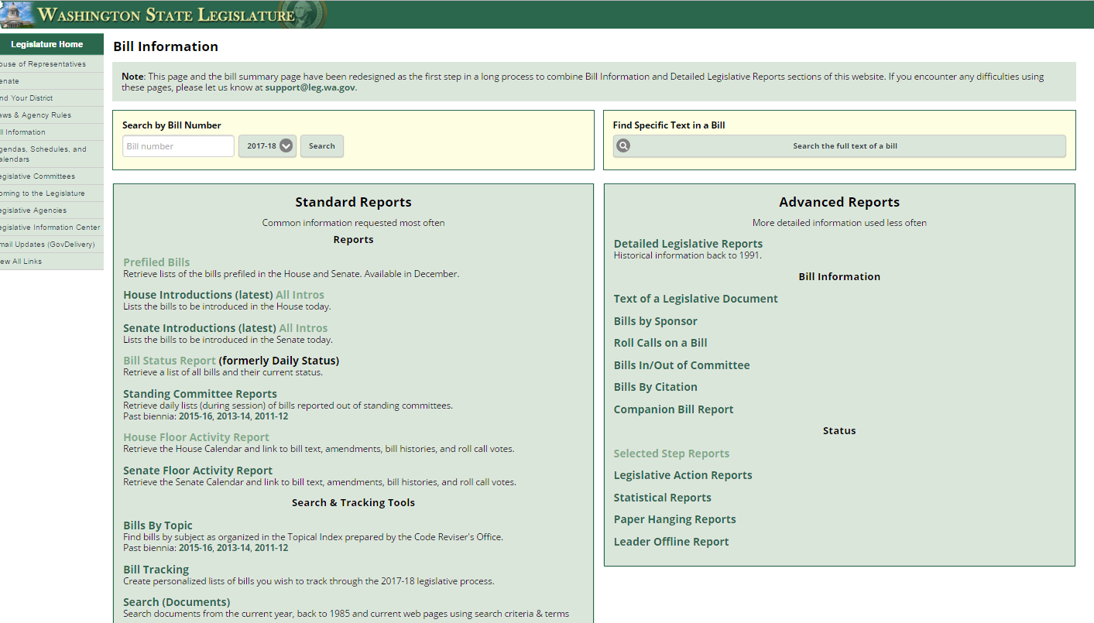
What is the status of XX bill?
Bill Information and Tracking - From these pages you can follow the bills you are most interested in and also provide comments on bills.
Bill Information page provides more in-depth options for learning more about what’s happening
Roll Call votes and other Bill details
Floor Activity Status

Slide 14
Participating & Providing Input
Rules Committees
House
Senate
Fiscal Committees
House Appropriations
Senate Ways & Means
House Capital Budget
Legislator Contacts
Ways to engage:
Email and call your legislators regarding bills that are scheduled for public hearing and/or executive sessions
Provide written testimony for WSSDA staff to share?
Come to Olympia – to testify! (not just to watch ☺)

Slide 15
WA State Legislature Resources
WA State Legislature
Bill Information and Tracking - From these pages you can follow the bills you are most interested in and also provide comments on bills.
Legislative Committee Information - Find out who is on what committee and what their meeting agendas include.
Schedules: To find more details on the Committee Meeting agendas, visit the House Committee or Senate Committee Web sites and click on the Committee you are interested in.
TVW - TVW is a great resource where you can watch hearings live, or go to the Archives to view past hearings of interest, just select the date and committee.

Slide 16
Things to remember
Looking Ahead

Slide 17
Next Week’s Webinar
Updates and Actions:
Week 7 recap
Bill and issue updates
Week 8 preview
Foundations:
TBD
What do you think?

Slide 18
2017 WSSDA Legislative Priorities http://wssda.org/Legislative/OurPrioritiesPositions.aspx
2016 Legislative Assembly (September)
95 school district board delegates
Deliberated 62 legislative positions
2017 Priorities (Top 20 rankings from Leg. Assembly)
Invest in our students
Funding, levies, revenue
Support our schools
Facilities, school construction & siting
Public records requests
Attract and retain quality staff
Compensation
Bargaining
Teacher recruitment, retention, professional development
Joint Association Ed Funding Priorities
Prioritized To-Do List for Education Funding

Slide 19
WSSDA Resources for learning and communications
New: 2017 Education Budget Proposal web page – includes general information about proposals along with side-by-side comparisons
WSSDA’s Legislative Representative Web Page – this is a new web page just for school district board legislative reps. It is where you can register for the weekly updates and also access quick links for legislative activities.
WSSDA Legislative Updates - Includes weekly committee schedules, bill watch lists, and WSSDA’s legislative updates during the legislative session
WSSDA Advocacy Resources - Organized by WSSDA position categories

Slide 20
WSSDA Resources, cont’d
WSSDA opportunities:
Know and Access your Legislative Committee DA Representatives (elected at Annual Conference)
Participate in key statewide events:
WSSDA Legislative Assembly – set WSSDA’s legislative priorities (Sept)
Legislative Conference and Day on the Hill in Olympia (with WASA / WASBO) (Jan/Feb)
Serve as your board’s Legislative Representative, discuss issues with your board
Attend WSSDA Regional meetings in the Spring or Fall
Tune-in:
Sign-up for WSSDA eClips
During session: weekly Legislative Updates to members;
Social media (Facebook & Twitter):You don’t have to have an account to follow “tweeters” during the session!
Follow Jessica or #wssdaleg and also check out #WAedu and #WAleg

Slide 21
In closing….Why are YOUR legislative partnerships & priorities important?
1.1 million
K-12 Students
295
School districts
147
Legislators
1,477
YOU
YOU’VE been entrusted in your community
Power in numbers and voice
How can we better engage / involve Leg. Reps across the state??
Decisions made in Olympia DO and WILL affect your district

Slide 22
Questions / Comments?
Use the Chat/Question Box
Or
Contact: Jessica Vavrus, Gov’t Relations Director, j.vavrus@wssda.org ; 360-890-5867

Slide 23
Thank you!
Talk to you next week!

